Slide 1
CHAPTER 15 Part 1 of 2
All photographic and graphic images (henceforth referred to as images) posted on this site are copyright of the persons and/or institutions indicated in the caption directly associated with each image. The copyright holders have agreed that you may use their images for educational, non-commercial purposes only and provided that they are credited in each instance of use. For all other uses you must contact the copyright holder.

Slide 2
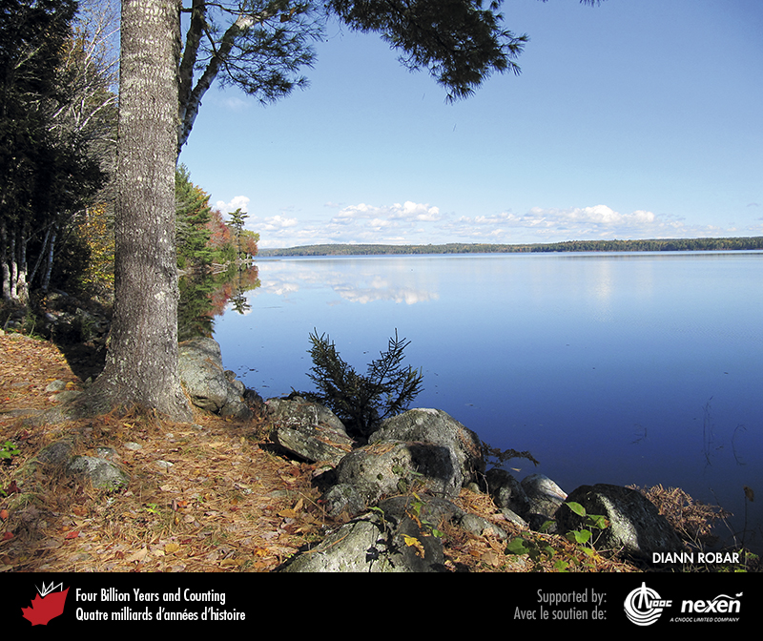
Notes:
Calm water on Sherbrooke Lake, Nova Scotia. DIANN ROBAR.
_______________________________
All photographic and graphic images (henceforth referred to as images) posted on this site are copyright of the persons and/or institutions indicated in the caption directly associated with each image. The copyright holders have agreed that you may use their images for educational, non-commercial purposes only and provided that they are credited in each instance of use. For all other uses you must contact the copyright holder.

Slide 3
Notes:
A mixed Prairie grassland under good moisture conditions, Grasslands National Park of Canada, Saskatchewan. W. LYNCH, COPYRIGHT PARKS CANADA.
_______________________________
All photographic and graphic images (henceforth referred to as images) posted on this site are copyright of the persons and/or institutions indicated in the caption directly associated with each image. The copyright holders have agreed that you may use their images for educational, non-commercial purposes only and provided that they are credited in each instance of use. For all other uses you must contact the copyright holder.

Slide 4
Notes:
Farmland suffering drought in southwestern Saskatchewan. ROB FENSOME.
_______________________________
All photographic and graphic images (henceforth referred to as images) posted on this site are copyright of the persons and/or institutions indicated in the caption directly associated with each image. The copyright holders have agreed that you may use their images for educational, non-commercial purposes only and provided that they are credited in each instance of use. For all other uses you must contact the copyright holder.

Slide 5
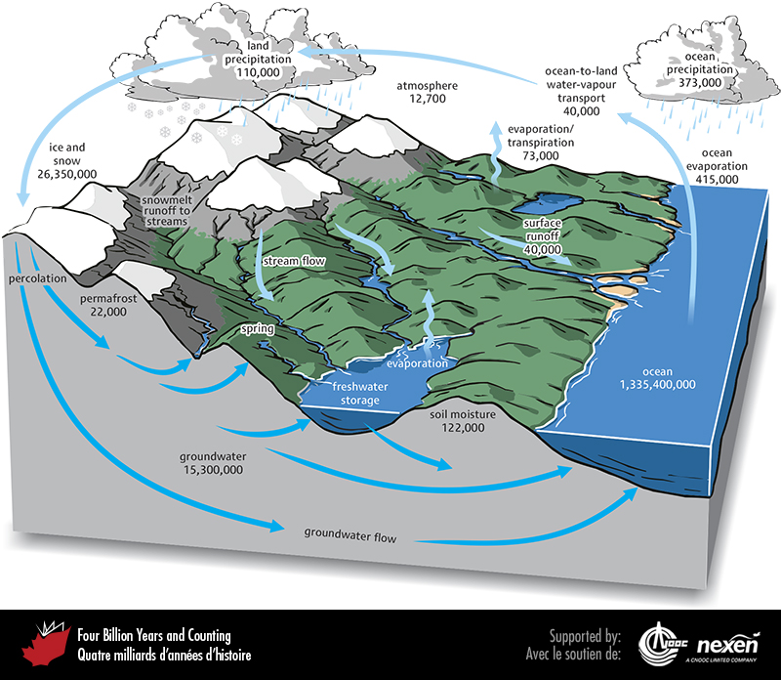
Notes:
The hydrological cycle begins with the evaporation of seawater to create the world’s ongoing supply of fresh water. Moisture-filled air formed over the oceans brings fresh water onto the continents, where it precipitates and eventually returns to the ocean through rivers and groundwater seepage to complete the cycle. Numbers represent in cubic kilometres how much water is either in storage or moving through the various parts of the water cycle on average in one year: for example, 415,000 cubic kilometres refers to the amount of ocean evaporation, of which 373,000 cubic kilometres is returned to the ocean as precipitation, and 15,300 cubic kilometres is stored in groundwater.
_______________________________
All photographic and graphic images (henceforth referred to as images) posted on this site are copyright of the persons and/or institutions indicated in the caption directly associated with each image. The copyright holders have agreed that you may use their images for educational, non-commercial purposes only and provided that they are credited in each instance of use. For all other uses you must contact the copyright holder.

Slide 6
Notes:
About 65 percent of the planet’s fresh water is locked up in glacier ice, as in this glacier west of McKinley Bay, northern Ellesmere Island, Nunavut. STEVE GRASBY.
_______________________________
All photographic and graphic images (henceforth referred to as images) posted on this site are copyright of the persons and/or institutions indicated in the caption directly associated with each image. The copyright holders have agreed that you may use their images for educational, non-commercial purposes only and provided that they are credited in each instance of use. For all other uses you must contact the copyright holder.

Slide 7
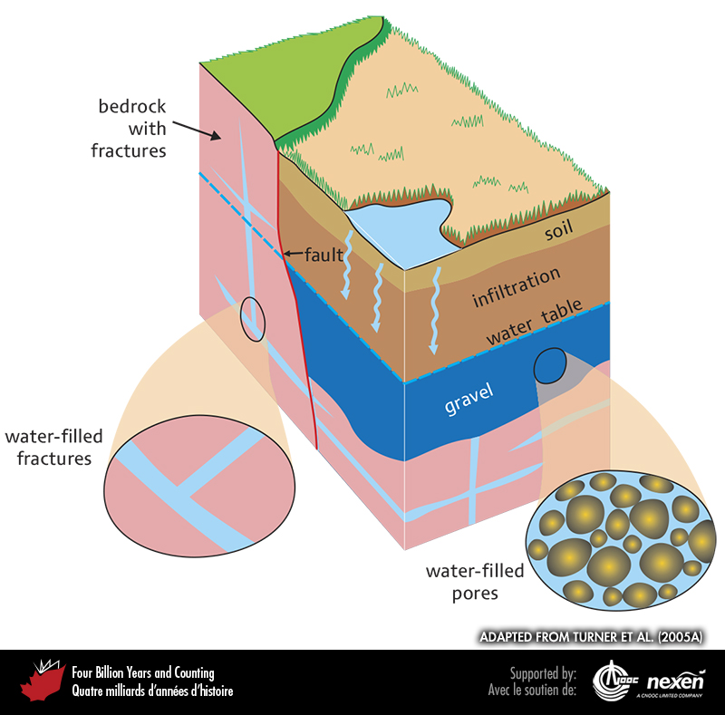
Notes:
Water that soaks into the ground fills pores and fractures in soil or rock to become groundwater. Pores and fractures below the water table are saturated with groundwater. ADAPTED FROM TURNER ET AL. (2005A).
_______________________________
All photographic and graphic images (henceforth referred to as images) posted on this site are copyright of the persons and/or institutions indicated in the caption directly associated with each image. The copyright holders have agreed that you may use their images for educational, non-commercial purposes only and provided that they are credited in each instance of use. For all other uses you must contact the copyright holder.

Slide 8
Notes:
Tulita Spring, near the confluence of the Mackenzie and Great Bear rivers in the Northwest Territories, brings groundwater to the surface. STEVE GRASBY.
_______________________________
All photographic and graphic images (henceforth referred to as images) posted on this site are copyright of the persons and/or institutions indicated in the caption directly associated with each image. The copyright holders have agreed that you may use their images for educational, non-commercial purposes only and provided that they are credited in each instance of use. For all other uses you must contact the copyright holder.

Slide 9
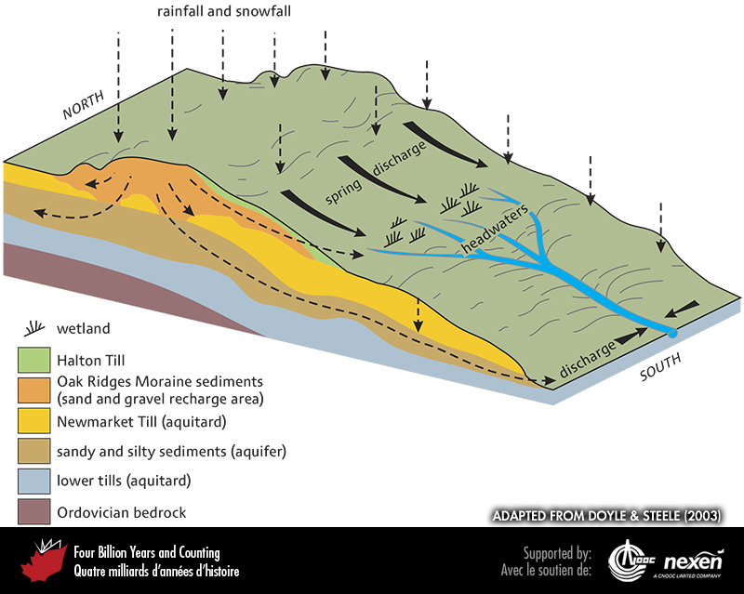
Notes:
Section through the Oak Ridges Moraine of southern Ontario. Water can move relatively easily into and through porous, permeable material. When saturated by water from rain and melted snow (recharge), the sediments exposed at ground level and extending below the surface become reservoirs of groundwater known as aquifers. Groundwater movement is restricted by impermeable layers, or aquitards. In this example, the groundwater of the Oak Ridges Moraine supports stream and wetland ecosystems. To safeguard this water, areas where recharge occurs must be protected. ADAPTED FROM DOYLE AND STEELE (2003).
_______________________________
All photographic and graphic images (henceforth referred to as images) posted on this site are copyright of the persons and/or institutions indicated in the caption directly associated with each image. The copyright holders have agreed that you may use their images for educational, non-commercial purposes only and provided that they are credited in each instance of use. For all other uses you must contact the copyright holder.

Slide 10
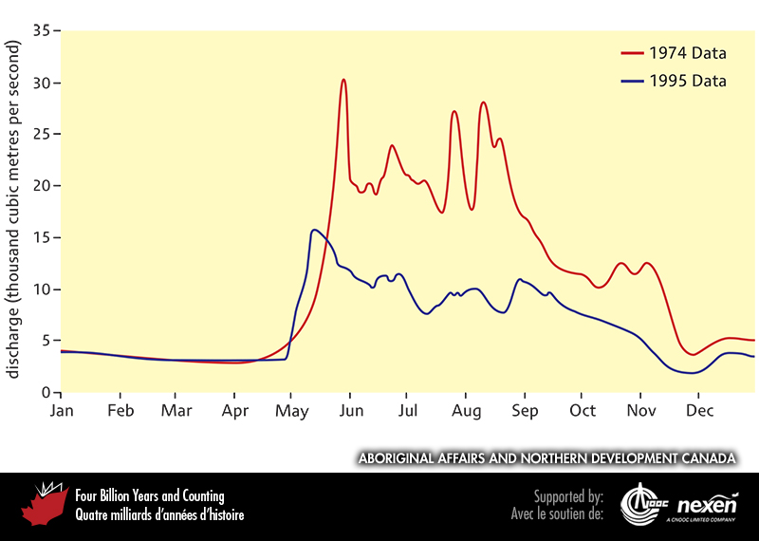
Notes:
The flow of rivers varies dramatically through the year. The Mackenzie River (shown here) has peak discharge in the late spring when snow is melting and then wanes through the summer and fall. The low-flow period of the winter and early spring is when the water supply is predominantly fed by groundwater discharge. Changes in annual precipitation can have significant impacts on flow from year to year as shown by the pattern of the maximum (1974) and minimum (1995) daily discharge of the Mackenzie into the Beaufort Sea at Arctic Red River. ADAPTED FROM ABORIGINAL AFFAIRS AND NORTHERN DEVELOPMENT CANADA WEBSITE.
_______________________________
All photographic and graphic images (henceforth referred to as images) posted on this site are copyright of the persons and/or institutions indicated in the caption directly associated with each image. The copyright holders have agreed that you may use their images for educational, non-commercial purposes only and provided that they are credited in each instance of use. For all other uses you must contact the copyright holder.

