Slide 1
CHAPTER 6 Part 1 of 2
All photographic and graphic images (henceforth referred to as images) posted on this site are copyright of the persons and/or institutions indicated in the caption directly associated with each image. The copyright holders have agreed that you may use their images for educational, non-commercial purposes only and provided that they are credited in each instance of use. For all other uses you must contact the copyright holder.

Slide 2
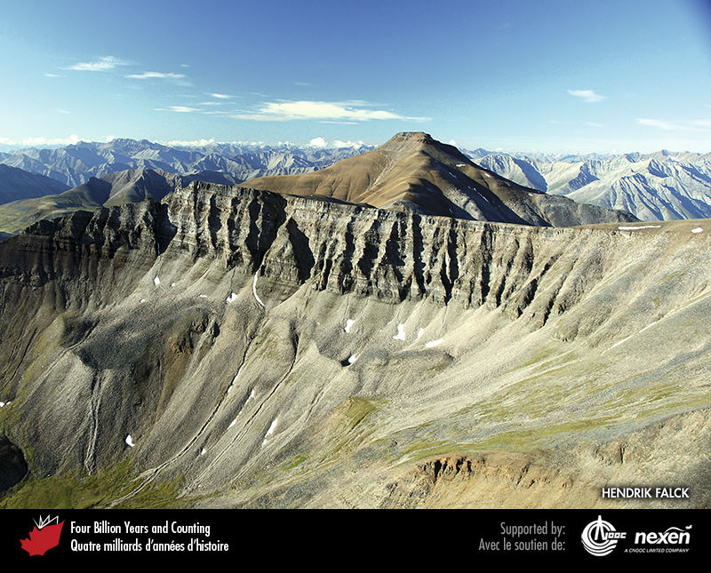
Notes:
In this view of the front ranges of the northern Mackenzie Mountains, Northwest Territories, Neoproterozoic deltaic deposits of the Amundsen-Mackenzie Mountains Basin are represented by resistant quartz-rich sandstone overlain by brown shaly layers. HENDRIK FALCK.
_______________________________
All photographic and graphic images (henceforth referred to as images) posted on this site are copyright of the persons and/or institutions indicated in the caption directly associated with each image. The copyright holders have agreed that you may use their images for educational, non-commercial purposes only and provided that they are credited in each instance of use. For all other uses you must contact the copyright holder.

Slide 3
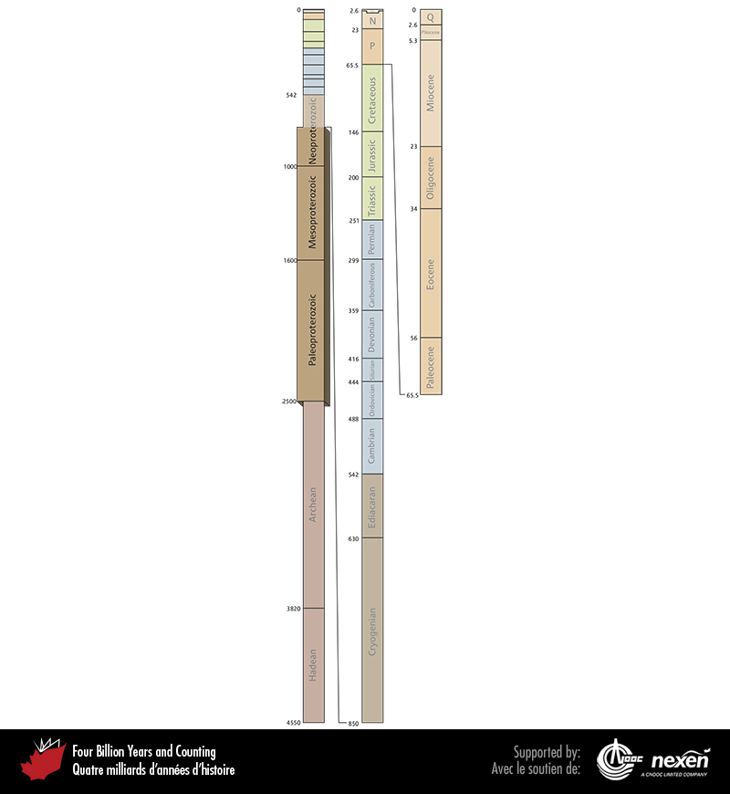
Notes:
Geologic time scale, showing the interval covered in this chapter. Numbers indicate millions of years ago. P = Paleogene (Paleocene to Oligocene), N = Neogene (Miocene and Pliocene), and Q = Quaternary.
_______________________________
All photographic and graphic images (henceforth referred to as images) posted on this site are copyright of the persons and/or institutions indicated in the caption directly associated with each image. The copyright holders have agreed that you may use their images for educational, non-commercial purposes only and provided that they are credited in each instance of use. For all other uses you must contact the copyright holder.

Slide 4
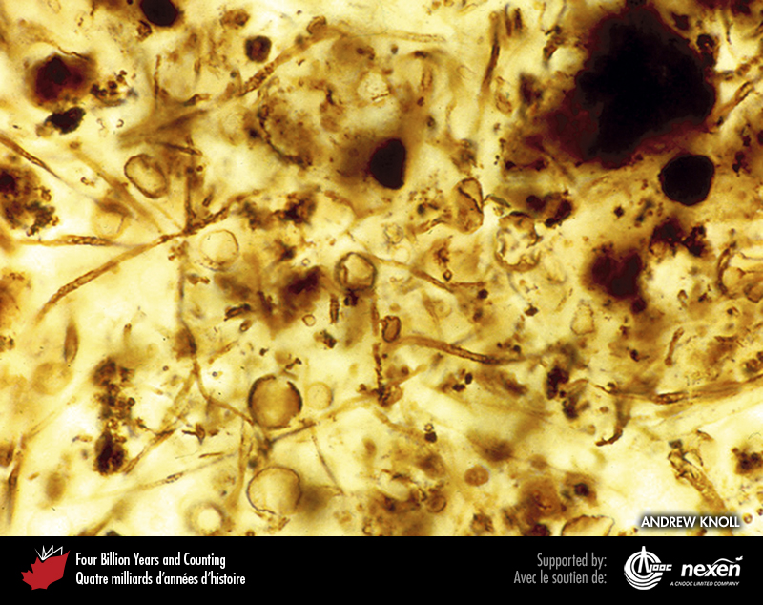
Notes:
Stanley Tyler set off the search for Precambrian life when he observed microfossils such as these in thin sections of Gunflint chert from northern Ontario. ANDREW KNOLL.
_______________________________
All photographic and graphic images (henceforth referred to as images) posted on this site are copyright of the persons and/or institutions indicated in the caption directly associated with each image. The copyright holders have agreed that you may use their images for educational, non-commercial purposes only and provided that they are credited in each instance of use. For all other uses you must contact the copyright holder.

Slide 5
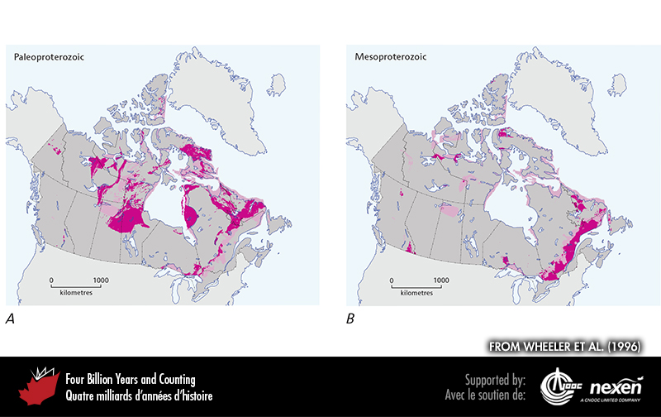
Notes:
General extent of Paleoproterozoic (A) and Mesoproterozoic (B) rocks at the surface (beneath glacial deposits), onshore and offshore. The lighter shaded areas denote either uncertainty or areas where rocks of the particular age have been confirmed but are intimately associated with rocks of other ages and the scale of the map doesn’t allow us to show them separately. ADAPTED FROM WHEELER ET AL. (1996).
_______________________________
All photographic and graphic images (henceforth referred to as images) posted on this site are copyright of the persons and/or institutions indicated in the caption directly associated with each image. The copyright holders have agreed that you may use their images for educational, non-commercial purposes only and provided that they are credited in each instance of use. For all other uses you must contact the copyright holder.

Slide 6
Notes:
Archean gneisses of the North Atlantic Craton are intruded by Paleoproterozoic mafic dykes, which are the dark bands in this 300-metre-high cliff north of Saglek Fiord, Labrador. BRUCE RYAN.
_______________________________
All photographic and graphic images (henceforth referred to as images) posted on this site are copyright of the persons and/or institutions indicated in the caption directly associated with each image. The copyright holders have agreed that you may use their images for educational, non-commercial purposes only and provided that they are credited in each instance of use. For all other uses you must contact the copyright holder.

Slide 7
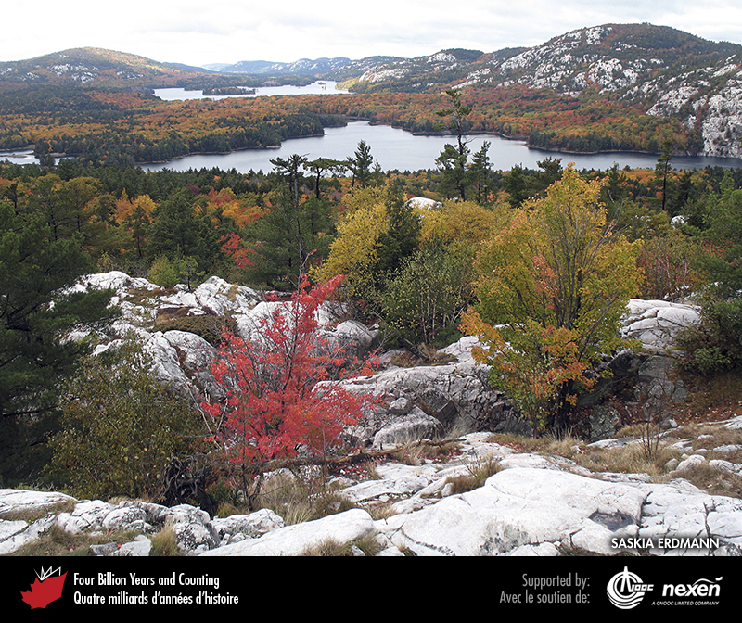
Notes:
Early Paleoproterozoic white sandstones in Killarney Provincial Park, Ontario. These rocks are part of the Huronian passive-margin succession. SASKIA ERDMANN.
_______________________________
All photographic and graphic images (henceforth referred to as images) posted on this site are copyright of the persons and/or institutions indicated in the caption directly associated with each image. The copyright holders have agreed that you may use their images for educational, non-commercial purposes only and provided that they are credited in each instance of use. For all other uses you must contact the copyright holder.

Slide 8
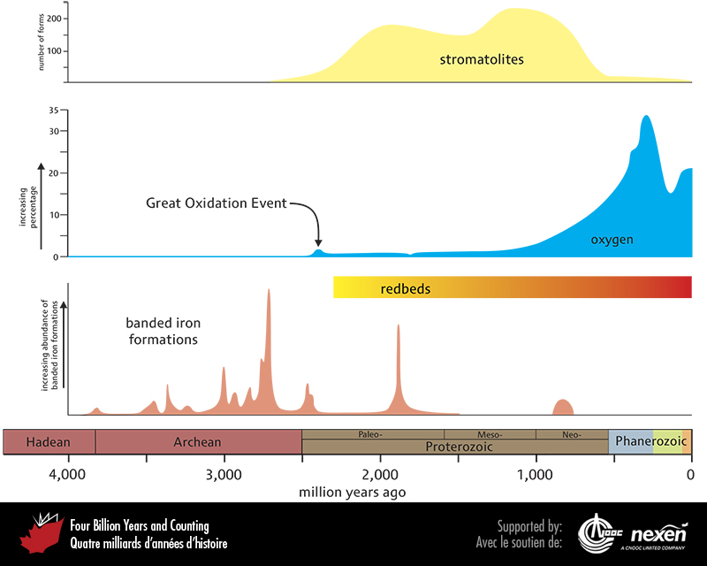
Notes:
Distribution through time of banded iron formations, redbeds, and stromatolites, and the changing atmospheric concentrations of oxygen. ADAPTED FROM VARIOUS SOURCES INCLUDING, ILYIN (2009), LYONS AND REINHARD (2009), RASMUSSENET AL . (2012), AND WALTERS AND HEYS (1985).
_______________________________
All photographic and graphic images (henceforth referred to as images) posted on this site are copyright of the persons and/or institutions indicated in the caption directly associated with each image. The copyright holders have agreed that you may use their images for educational, non-commercial purposes only and provided that they are credited in each instance of use. For all other uses you must contact the copyright holder.

Slide 9
Notes:
This Paleoproterozoic conglomerate near Elliot Lake, Ontario, is part of the Huronian passive-margin succession and is probably a debris-flow deposit. ROB RAINBIRD.
_______________________________
All photographic and graphic images (henceforth referred to as images) posted on this site are copyright of the persons and/or institutions indicated in the caption directly associated with each image. The copyright holders have agreed that you may use their images for educational, non-commercial purposes only and provided that they are credited in each instance of use. For all other uses you must contact the copyright holder.

Slide 10
Notes:
Tillite from the Paleoproterozoic Huronian succession, near Elliot Lake, Ontario. The alignment of the rock fragments is evidence that they were deposited beneath a flowing glacier. DARREL LONG.
_______________________________
All photographic and graphic images (henceforth referred to as images) posted on this site are copyright of the persons and/or institutions indicated in the caption directly associated with each image. The copyright holders have agreed that you may use their images for educational, non-commercial purposes only and provided that they are credited in each instance of use. For all other uses you must contact the copyright holder.

Slide 11
Notes:
In this scene at Lac Guillaume-Delisle, northern Quebec, the flat-topped hills in the middle distance are underlain by undeformed, 2,000-year-old, rift and passive-margin strata on a flank of the Superior Craton. The lower slopes are underlain by Archean gneiss. JEAN-YVES LABBÉ.
_______________________________
All photographic and graphic images (henceforth referred to as images) posted on this site are copyright of the persons and/or institutions indicated in the caption directly associated with each image. The copyright holders have agreed that you may use their images for educational, non-commercial purposes only and provided that they are credited in each instance of use. For all other uses you must contact the copyright holder.

Slide 12
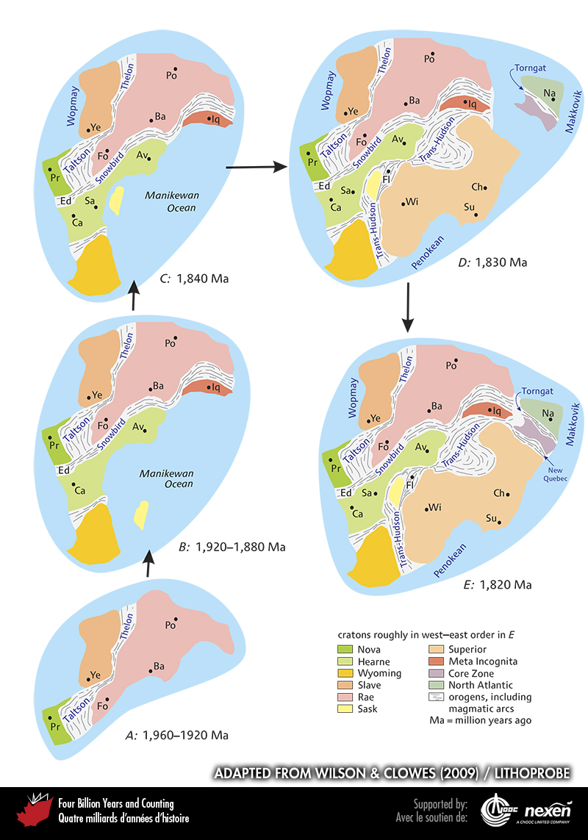
Notes:
The gradual coming together of Archean cratons (A–D) to form the Proterozoic supercontinent Nuna (E). The individual cratons are colour coded, as shown in the legend, and the locations of modern communities are shown for orientation: Av = Arviat, Nunavut; Ba = Baker Lake, Nunavut; Ca = Calgary, Alberta; Ch = Chibougamau, Quebec; Ed = Edmonton, Alberta; Fl = Flin Flon, Manitoba; Fo = Fond du Lac, Saskatchewan; Iq = Iqaluit, Nunavut; Na = Nain, Labrador; Po = Pond Inlet, Nunavut; Pr = Prince Rupert, British Columbia; Sa = Saskatoon, Saskatchewan; Su = Sudbury, Ontario; Wi = Winnipeg, Manitoba; Ye = Yellowknife, Northwest Territories.
_______________________________
All photographic and graphic images (henceforth referred to as images) posted on this site are copyright of the persons and/or institutions indicated in the caption directly associated with each image. The copyright holders have agreed that you may use their images for educational, non-commercial purposes only and provided that they are credited in each instance of use. For all other uses you must contact the copyright holder.

Slide 13
Notes:
Sandstone with giant cross-beds on Melville Peninsula, Nunavut. These rocks originated as eolian or fluvial sediments, which were deposited about 1,850 million years ago on Archean rocks of the Rae Craton during formation of the supercontinent Nuna. DAVID CORRIGAN.
_______________________________
All photographic and graphic images (henceforth referred to as images) posted on this site are copyright of the persons and/or institutions indicated in the caption directly associated with each image. The copyright holders have agreed that you may use their images for educational, non-commercial purposes only and provided that they are credited in each instance of use. For all other uses you must contact the copyright holder.

Slide 14
Notes:
These mountains in Auyuittuq National Park of Canada on southeastern Baffin Island are formed from granitic rocks of the Paleoproterozoic Cumberland Batholith. The Batholith was intruded along a subduction zone during the Trans-Hudson Orogeny 1,900 to 1,800 million years ago. J. POITEVIN, COPYRIGHT PARKS CANADA.
_______________________________
All photographic and graphic images (henceforth referred to as images) posted on this site are copyright of the persons and/or institutions indicated in the caption directly associated with each image. The copyright holders have agreed that you may use their images for educational, non-commercial purposes only and provided that they are credited in each instance of use. For all other uses you must contact the copyright holder.

Slide 15
Notes:
Intensely deformed conglomerate and amphibolite at Amisk Lake, northern Saskatchewan. The conglomerate originated as a river deposit 1,840 million years ago above rocks of the Flin Flon magmatic arc in the heart of the Nuna supercontinent. The amphibolite was originally a mafic sill that intruded the conglomerate. Some of the clasts are stretched, whereas others are only slightly distorted. LEN GAL.
_______________________________
All photographic and graphic images (henceforth referred to as images) posted on this site are copyright of the persons and/or institutions indicated in the caption directly associated with each image. The copyright holders have agreed that you may use their images for educational, non-commercial purposes only and provided that they are credited in each instance of use. For all other uses you must contact the copyright holder.

