Slide 1
CHAPTER 17 Part 1 of 2
All photographic and graphic images (henceforth referred to as images) posted on this site are copyright of the persons and/or institutions indicated in the caption directly associated with each image. The copyright holders have agreed that you may use their images for educational, non-commercial purposes only and provided that they are credited in each instance of use. For all other uses you must contact the copyright holder.

Slide 2
Notes:
Practically every year at least one part of Canada is affected by serious flooding. The Red River Valley in southern Manitoba is a particularly vulnerable area. During winter, heavy snow tends to accumulate upstream, leading to the possibility of devastating floods downstream during spring melt. The city of Winnipeg is protected from the worst impact of the “Red Sea” floods by the Red River Floodway, which channels peak flows around the city. RON GARNETT / AIRSCAPES.CA.
_______________________________
All photographic and graphic images (henceforth referred to as images) posted on this site are copyright of the persons and/or institutions indicated in the caption directly associated with each image. The copyright holders have agreed that you may use their images for educational, non-commercial purposes only and provided that they are credited in each instance of use. For all other uses you must contact the copyright holder.

Slide 3
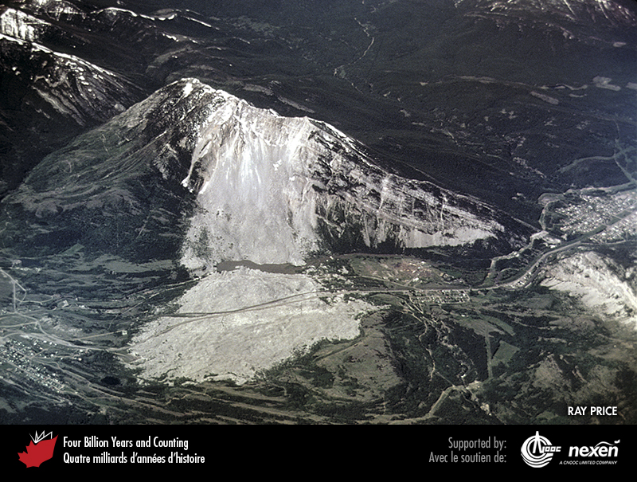
Notes:
The scar on Turtle Mountain and the debris field of the Frank Slide, southwestern Alberta. The debris lobe is now crossed by a highway and a railway. RAY PRICE.
_______________________________
All photographic and graphic images (henceforth referred to as images) posted on this site are copyright of the persons and/or institutions indicated in the caption directly associated with each image. The copyright holders have agreed that you may use their images for educational, non-commercial purposes only and provided that they are credited in each instance of use. For all other uses you must contact the copyright holder.

Slide 4
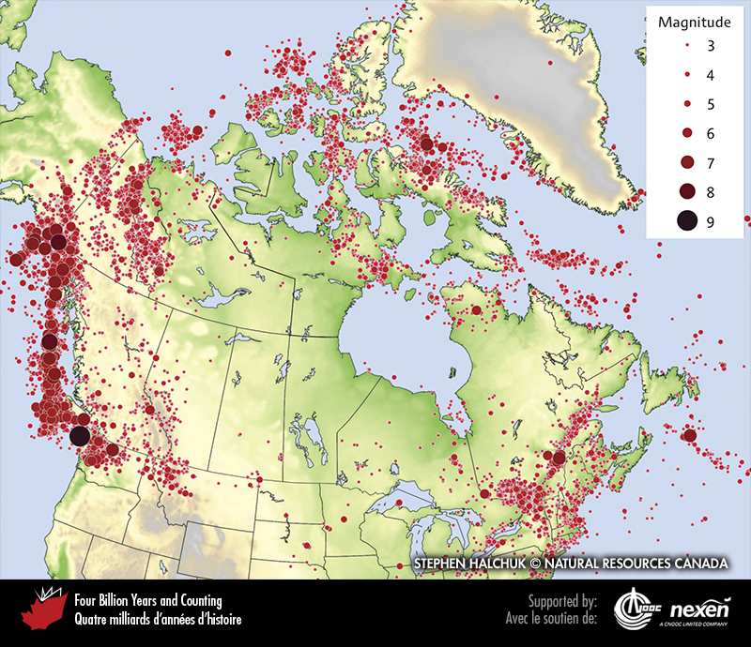
Notes:
Distribution of earthquakes larger than magnitude 2.5 in Canada. IMAGE COURTESY OF STEPHEN HALCHUK, GEOLOGICAL SURVEY OF CANADA (NATURAL RESOURCES CANADA).
_______________________________
All photographic and graphic images (henceforth referred to as images) posted on this site are copyright of the persons and/or institutions indicated in the caption directly associated with each image. The copyright holders have agreed that you may use their images for educational, non-commercial purposes only and provided that they are credited in each instance of use. For all other uses you must contact the copyright holder.

Slide 5
Notes:
A building that collapsed during the Kobe earthquake in Japan in January 1995. COURTESY OF THE UNITED STATES GEOLOGICAL SURVEY.
_______________________________
All photographic and graphic images (henceforth referred to as images) posted on this site are copyright of the persons and/or institutions indicated in the caption directly associated with each image. The copyright holders have agreed that you may use their images for educational, non-commercial purposes only and provided that they are credited in each instance of use. For all other uses you must contact the copyright holder.

Slide 6
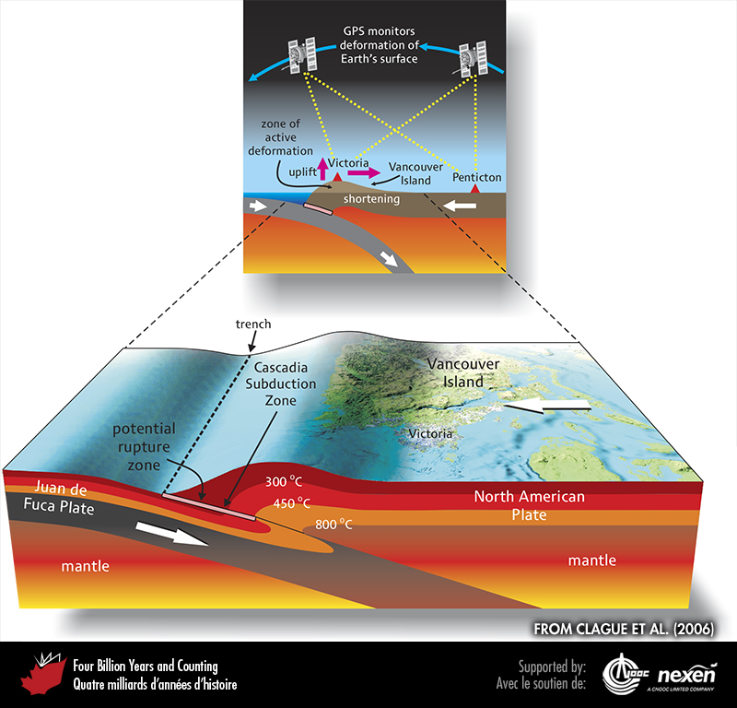
Notes:
The oceanic Juan de Fuca Plate is presently locked to the North American Plate where the temperature of the crust along the Cascadia Subduction Zone is less than 350°C. This locked region is where the next great Cascadia earthquake will be initiated. The 450°C isotherm delineates the landward limit of potential rupture; at higher temperatures the rocks are too ductile to break. Vancouver Island is being flexed upward due to compression and elastic shortening of the North American Plate above the locked interface. This deformation has been detected from satellite measurements of small changes in the relative position of points on the Earth’s surface. Sometime within the next several hundred years the plates will suddenly unlock, triggering a great earthquake. FROM CLAGUE ET AL. (2006), USED WITH PERMISSION OF THE AUTHORS AND TRICOUNI PRESS.
_______________________________
All photographic and graphic images (henceforth referred to as images) posted on this site are copyright of the persons and/or institutions indicated in the caption directly associated with each image. The copyright holders have agreed that you may use their images for educational, non-commercial purposes only and provided that they are credited in each instance of use. For all other uses you must contact the copyright holder.

Slide 7
Notes:
This section dug into a tidal marsh near Tofino, British Columbia, provides evidence for past earthquakes in the region. The tip of the knife is at the top of a buried marsh surface, which is in turn overlain by about 10 centimetres of tsunami-deposited sand. This and other evidence show that the marsh subsided and was inundated by a tsunami during the last great earthquake at the Cascadia Subduction Zone in January 1700. JOHN CLAGUE.
_______________________________
All photographic and graphic images (henceforth referred to as images) posted on this site are copyright of the persons and/or institutions indicated in the caption directly associated with each image. The copyright holders have agreed that you may use their images for educational, non-commercial purposes only and provided that they are credited in each instance of use. For all other uses you must contact the copyright holder.

Slide 8
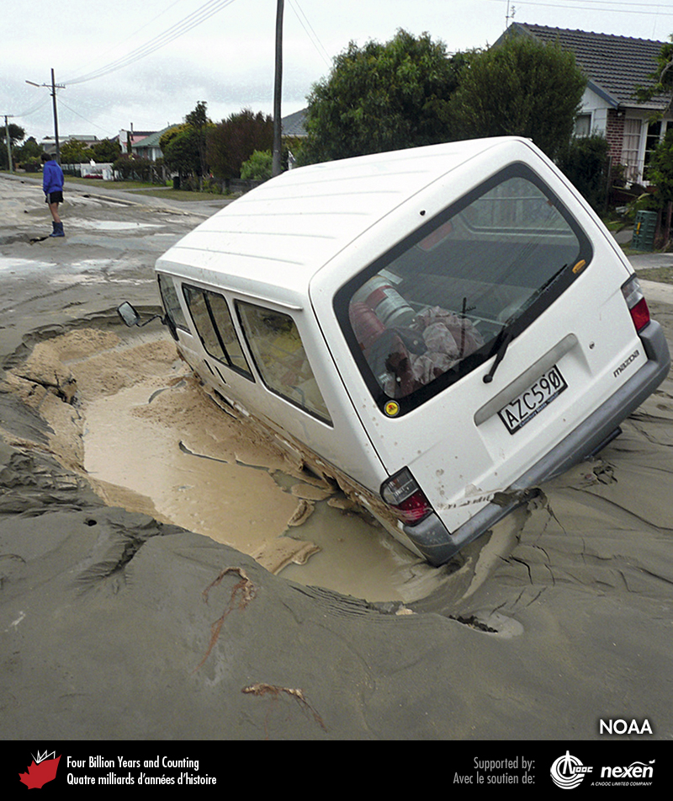
Notes:
Strong shaking during earthquakes can liquefy loose, water-saturated sediments, as in Christchurch, New Zealand, during the February 2011 earthquake. COURTESY OF NOAA.
_______________________________
All photographic and graphic images (henceforth referred to as images) posted on this site are copyright of the persons and/or institutions indicated in the caption directly associated with each image. The copyright holders have agreed that you may use their images for educational, non-commercial purposes only and provided that they are credited in each instance of use. For all other uses you must contact the copyright holder.

Slide 9
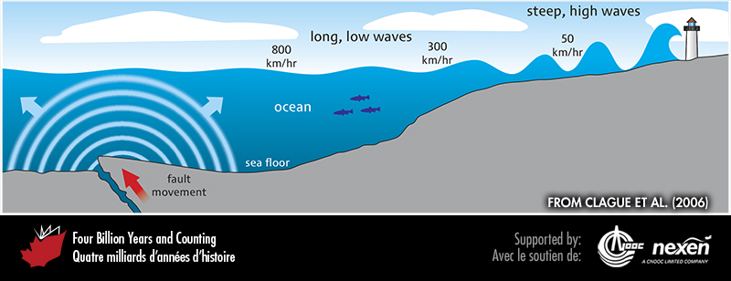
Notes:
A tsunami can be triggered by rupture of the sea floor along a fault during an earthquake. The sudden upward displacement of the sea floor produces tsunami, which often have a deadly impact when they reach shore. The values in kilometres-per-hour show how much a tsunami loses speed as it moves shoreward. FROM CLAGUE ET AL. (2006), USED WITH PERMISSION OF THE AUTHORS AND TRICOUNI PRESS.
_______________________________
All photographic and graphic images (henceforth referred to as images) posted on this site are copyright of the persons and/or institutions indicated in the caption directly associated with each image. The copyright holders have agreed that you may use their images for educational, non-commercial purposes only and provided that they are credited in each instance of use. For all other uses you must contact the copyright holder.

Slide 10
Notes:
Destruction wrought by the 2010 earthquake and tsunami on the Oshika Peninsula, northeastern Japan. COURTESY OF NOAA.
_______________________________
All photographic and graphic images (henceforth referred to as images) posted on this site are copyright of the persons and/or institutions indicated in the caption directly associated with each image. The copyright holders have agreed that you may use their images for educational, non-commercial purposes only and provided that they are credited in each instance of use. For all other uses you must contact the copyright holder.

Slide 11
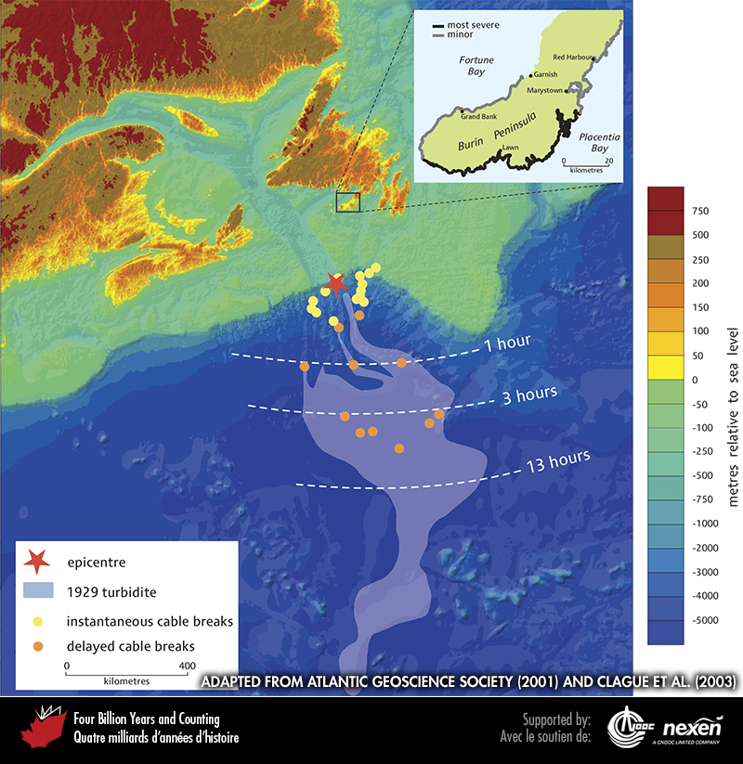
Notes:
The extent of the turbidity current deposit associated with the Grand Banks Earthquake of November 1929, and the timing of breaks to submarine cables caused by the powerful bottom current. The inset shows the parts of the Newfoundland coastline affected by the tsunami generated by this earthquake. The terms “most severe” and “minor” refer to physical damage to docks, wharves, boats, and buildings. MAIN FIGURE FROM ATLANTIC GEOSCIENCE SOCIETY (2001); INSET ADAPTED FROM CLAGUE ET AL. (2003).
_______________________________
All photographic and graphic images (henceforth referred to as images) posted on this site are copyright of the persons and/or institutions indicated in the caption directly associated with each image. The copyright holders have agreed that you may use their images for educational, non-commercial purposes only and provided that they are credited in each instance of use. For all other uses you must contact the copyright holder.

Slide 12
Notes:
The crater in the Tseax Cone, which erupted around 1775, producing an explosive pyrotechnics show, is vividly remembered in Nisga’a oral history. The Tseax Cone and its associated lavas are part of the Stikine Volcanic Belt in northern British Columbia. CATHERINE HICKSON.
_______________________________
All photographic and graphic images (henceforth referred to as images) posted on this site are copyright of the persons and/or institutions indicated in the caption directly associated with each image. The copyright holders have agreed that you may use their images for educational, non-commercial purposes only and provided that they are credited in each instance of use. For all other uses you must contact the copyright holder.

