Slide 1
INTRODUCTION
All photographic and graphic images (henceforth referred to as images) posted on this site are copyright of the persons and/or institutions indicated in the caption directly associated with each image. The copyright holders have agreed that you may use their images for educational, non-commercial purposes only and provided that they are credited in each instance of use. For all other uses you must contact the copyright holder.

Slide 2
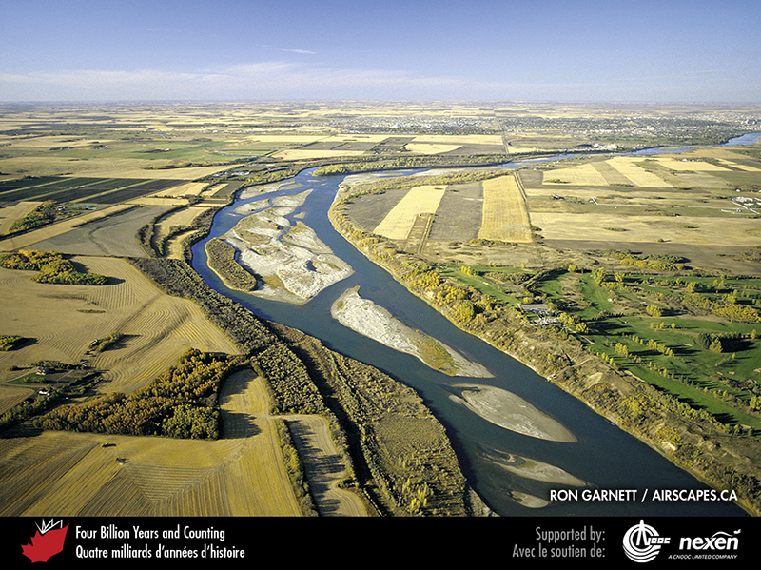
Notes:
The vastness of Canada is nowhere better appreciated than in the Prairie Provinces. This aerial view is of the South Saskatchewan River near Saskatoon, Saskatchewan. RON GARNETT / AIRSCAPES.CA.
_______________________________
All photographic and graphic images (henceforth referred to as images) posted on this site are copyright of the persons and/or institutions indicated in the caption directly associated with each image. The copyright holders have agreed that you may use their images for educational, non-commercial purposes only and provided that they are credited in each instance of use. For all other uses you must contact the copyright holder.

Slide 3
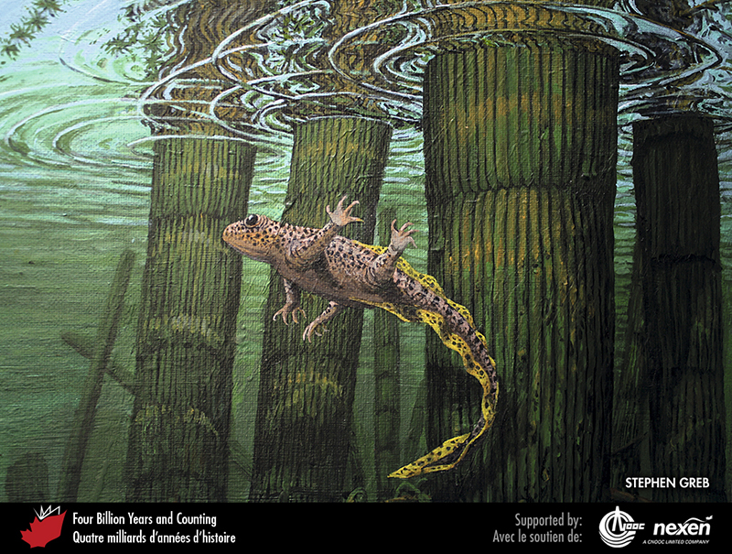
Notes:
An early amphibian navigates its way around submerged stems of the horsetail Calamites in this scene based on fossil finds from rocks about 310 million years old in the Maritime Provinces. STEPHEN GREB.
______________________________
All photographic and graphic images (henceforth referred to as images) posted on this site are copyright of the persons and/or institutions indicated in the caption directly associated with each image. The copyright holders have agreed that you may use their images for educational, non-commercial purposes only and provided that they are credited in each instance of use. For all other uses you must contact the copyright holder.

Slide 4
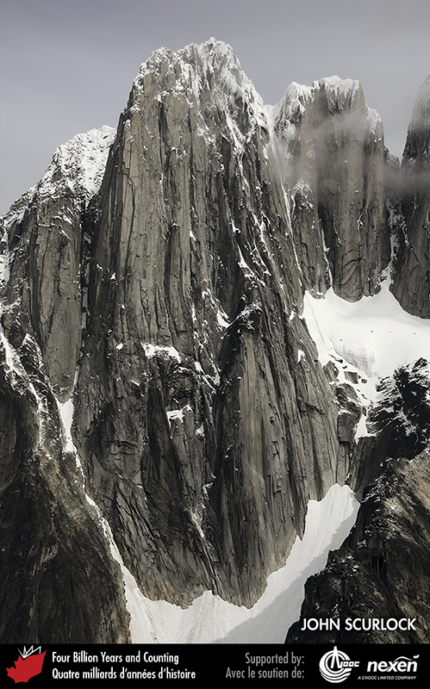
Notes:
The collision of tectonic plates causes the Earth’s crust to be uplifted on a regional scale. As the surface rises it is sculpted by erosion into mountains and valleys, as at North Howser Tower in the Kootenays of southeastern British Columbia. JOHN SCURLOCK.
______________________________
All photographic and graphic images (henceforth referred to as images) posted on this site are copyright of the persons and/or institutions indicated in the caption directly associated with each image. The copyright holders have agreed that you may use their images for educational, non-commercial purposes only and provided that they are credited in each instance of use. For all other uses you must contact the copyright holder.

