Slide 1
CHAPTER 4 Part 2 of 2
All photographic and graphic images (henceforth referred to as images) posted on this site are copyright of the persons and/or institutions indicated in the caption directly associated with each image. The copyright holders have agreed that you may use their images for educational, non-commercial purposes only and provided that they are credited in each instance of use. For all other uses you must contact the copyright holder.

Slide 2
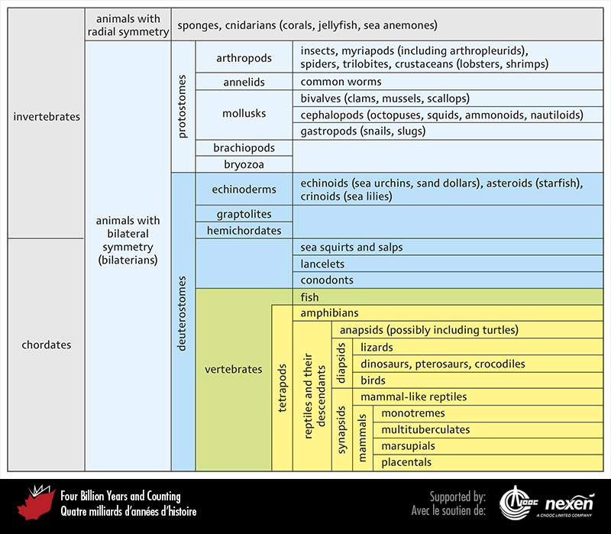
Notes:
A quick guide to the names used for the major groups of animals (metazoans).
_______________________________
All photographic and graphic images (henceforth referred to as images) posted on this site are copyright of the persons and/or institutions indicated in the caption directly associated with each image. The copyright holders have agreed that you may use their images for educational, non-commercial purposes only and provided that they are credited in each instance of use. For all other uses you must contact the copyright holder.

Slide 3
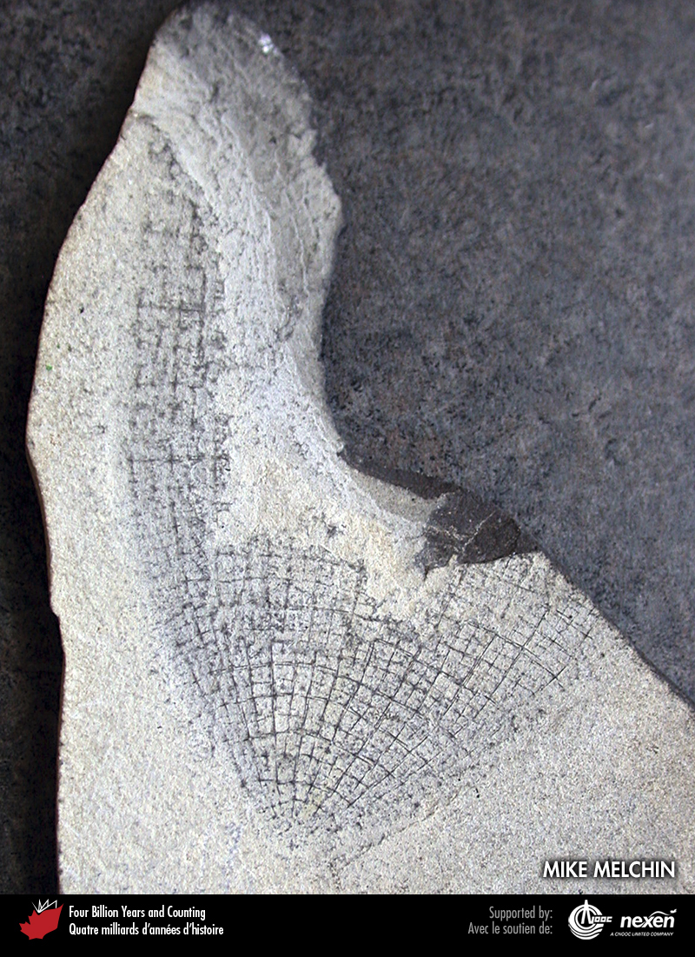
Notes:
A fossil sponge from Silurian rocks of Cornwallis Island, Nunavut. MIKE MELCHIN.
_______________________________
All photographic and graphic images (henceforth referred to as images) posted on this site are copyright of the persons and/or institutions indicated in the caption directly associated with each image. The copyright holders have agreed that you may use their images for educational, non-commercial purposes only and provided that they are credited in each instance of use. For all other uses you must contact the copyright holder.

Slide 4
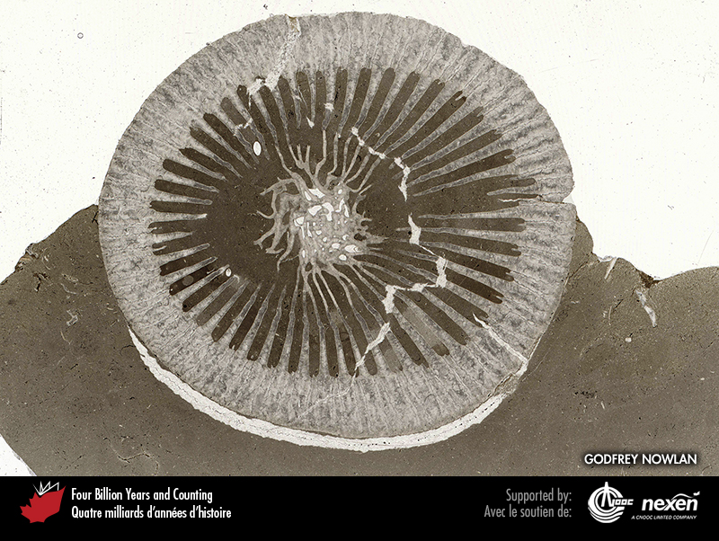
Notes:
Thin section of the solitary horn coral Streptelasma from late Ordovician rocks at Fossil Creek, Southampton Island, Nunavut. GODFREY NOWLAN.
_______________________________
All photographic and graphic images (henceforth referred to as images) posted on this site are copyright of the persons and/or institutions indicated in the caption directly associated with each image. The copyright holders have agreed that you may use their images for educational, non-commercial purposes only and provided that they are credited in each instance of use. For all other uses you must contact the copyright holder.

Slide 5
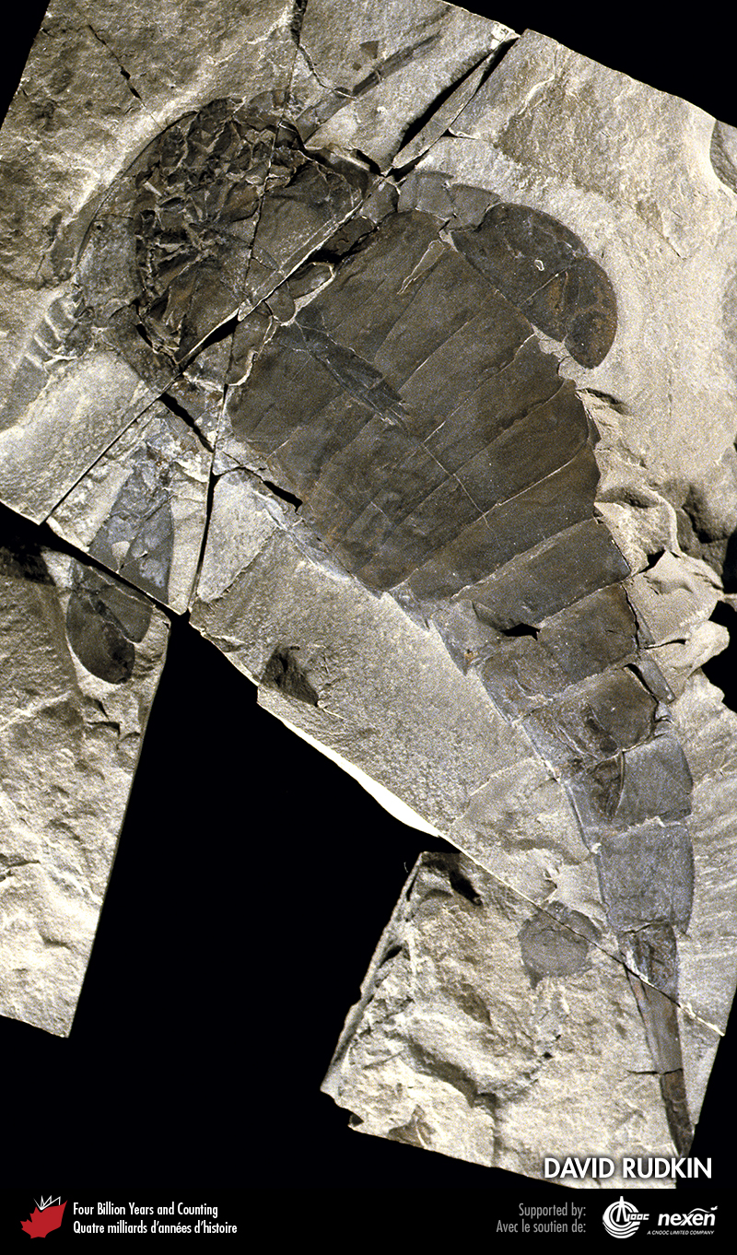
Notes:
Eurypterids were arthropods and top marine predators during parts of the Paleozoic. This specimen of Eurypterus remipes came from late Silurian rocks near Ridgemount, Ontario. DAVID RUDKIN.
_______________________________
All photographic and graphic images (henceforth referred to as images) posted on this site are copyright of the persons and/or institutions indicated in the caption directly associated with each image. The copyright holders have agreed that you may use their images for educational, non-commercial purposes only and provided that they are credited in each instance of use. For all other uses you must contact the copyright holder.

Slide 6
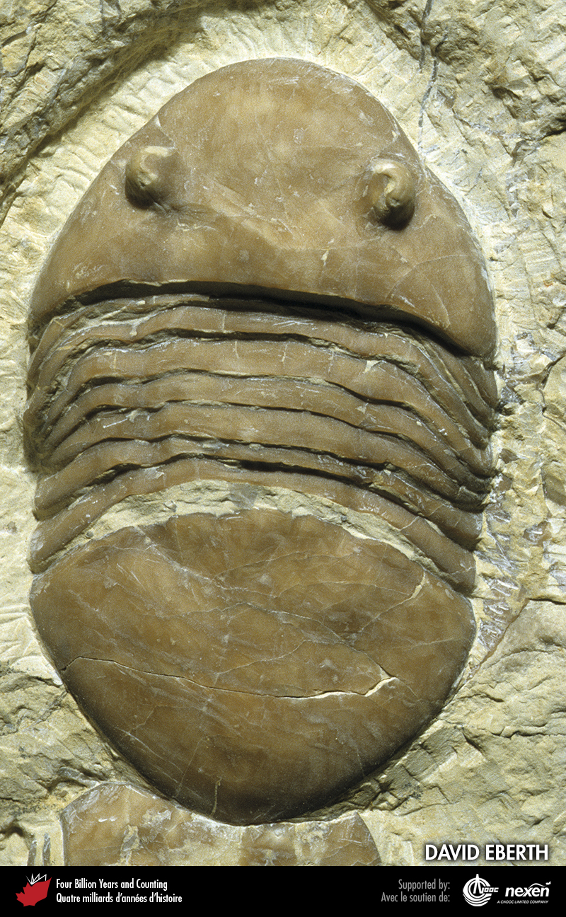
Notes:
A specimen of Isotelus, an Ordovician trilobite, from Bowmanville, Ontario. Trilobites were among the first shelled bilaterians. DAVID EBERTH.
_______________________________
All photographic and graphic images (henceforth referred to as images) posted on this site are copyright of the persons and/or institutions indicated in the caption directly associated with each image. The copyright holders have agreed that you may use their images for educational, non-commercial purposes only and provided that they are credited in each instance of use. For all other uses you must contact the copyright holder.

Slide 7
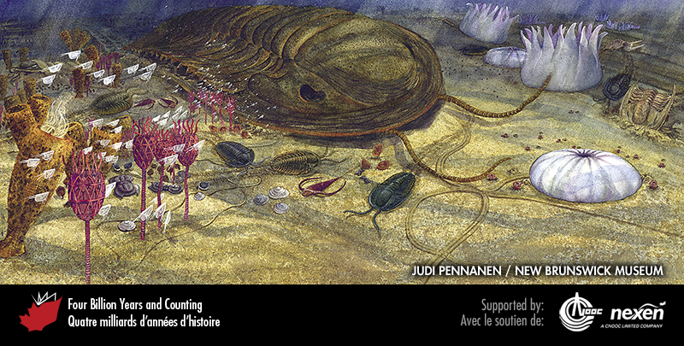
Notes:
The Cambrian sea floor was dominated by invertebrates, as shown in this scene based on fossils found in the Saint John area of New Brunswick. Several species of trilobites can be seen. To the right are white jellyfish-like creatures, whose inclusion in the painting was based on structures now no longer believed to have an organic origin. Several red eocrinoids stand like sentinels to the left, with a group of translucent ostracods (small arthropods) floating by. Behind the eocrinoids are brown sponges, and some small brown brachiopods are about to be steamrollered by the big trilobite. PAINTING BY JUDI PENNANEN, COURTESY OF THE NEW BRUNSWICK MUSEUM.
_______________________________
All photographic and graphic images (henceforth referred to as images) posted on this site are copyright of the persons and/or institutions indicated in the caption directly associated with each image. The copyright holders have agreed that you may use their images for educational, non-commercial purposes only and provided that they are credited in each instance of use. For all other uses you must contact the copyright holder.

Slide 8
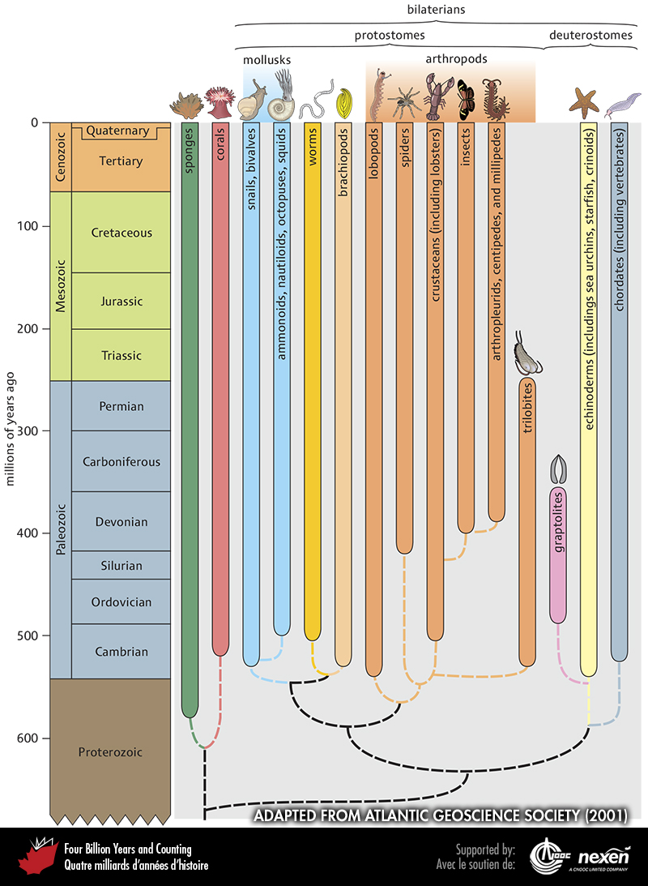
Notes:
Evolutionary relationships and the timing of first appearances and ranges of the main groups of invertebrates. Probable interrelationships are shown by the dashed lines. ADAPTED FROM ATLANTIC GEOSCIENCE SOCIETY (2001).
_______________________________
All photographic and graphic images (henceforth referred to as images) posted on this site are copyright of the persons and/or institutions indicated in the caption directly associated with each image. The copyright holders have agreed that you may use their images for educational, non-commercial purposes only and provided that they are credited in each instance of use. For all other uses you must contact the copyright holder.

Slide 9
Notes:
Asteroids (starfish) are a group of echinoderms that are not common as fossils. This specimen is from Quaternary sediments near Saint John, New Brunswick. HEINZ WIELE, COURTESY OF THE ATLANTIC GEOSCIENCE SOCIETY; SPECIMEN COURTESY OF THE NEW BRUNSWICK MUSEUM.
_______________________________
All photographic and graphic images (henceforth referred to as images) posted on this site are copyright of the persons and/or institutions indicated in the caption directly associated with each image. The copyright holders have agreed that you may use their images for educational, non-commercial purposes only and provided that they are credited in each instance of use. For all other uses you must contact the copyright holder.

Slide 10
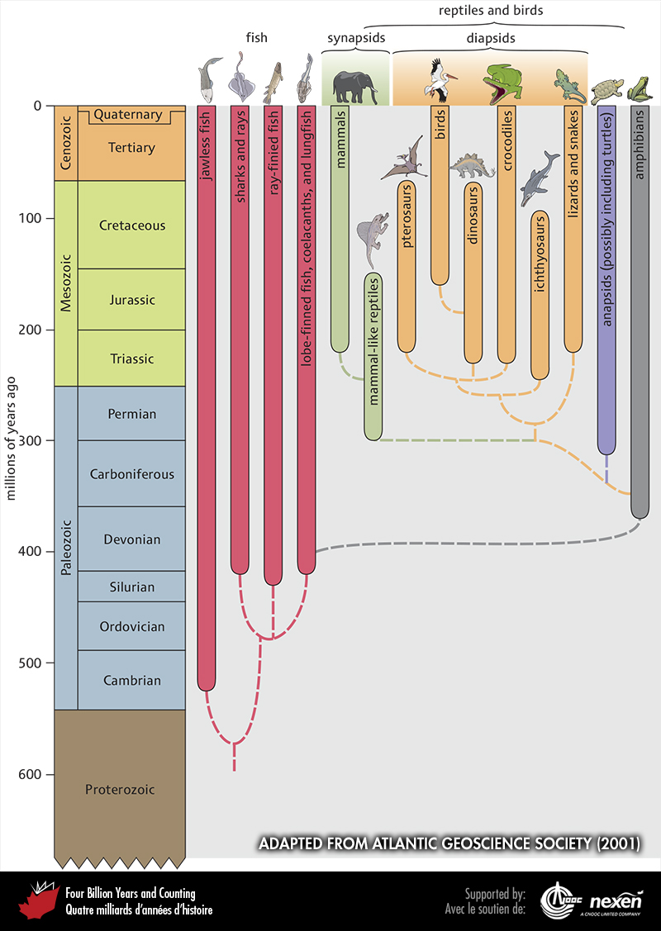
Notes:
Evolutionary relationships and the timing of first appearances and ranges of the main groups of vertebrates. Probable interrelationships are shown by the dashed lines. ADAPTED FROM ATLANTIC GEOSCIENCE SOCIETY (2001).
_______________________________
All photographic and graphic images (henceforth referred to as images) posted on this site are copyright of the persons and/or institutions indicated in the caption directly associated with each image. The copyright holders have agreed that you may use their images for educational, non-commercial purposes only and provided that they are credited in each instance of use. For all other uses you must contact the copyright holder.

Slide 11
Notes:
Graptolites from early Silurian rocks at Arisaig, Nova Scotia. HEINZ WIELE, COURTESY OF THE ATLANTIC GEOSCIENCE SOCIETY.
_______________________________
All photographic and graphic images (henceforth referred to as images) posted on this site are copyright of the persons and/or institutions indicated in the caption directly associated with each image. The copyright holders have agreed that you may use their images for educational, non-commercial purposes only and provided that they are credited in each instance of use. For all other uses you must contact the copyright holder.

Slide 12
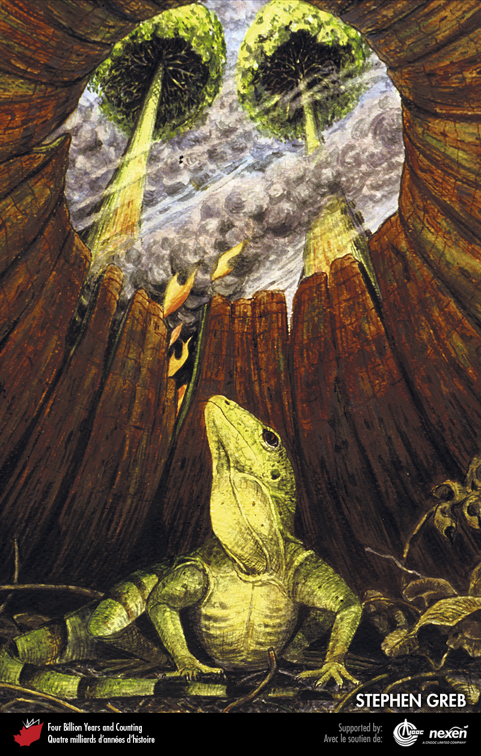
Notes:
In this scene based on fossil finds from late Carboniferous rocks at Joggins, Nova Scotia, an early reptile gazes out of a tree stump as a forest fire approaches. STEPHEN GREB. _______________________________
All photographic and graphic images (henceforth referred to as images) posted on this site are copyright of the persons and/or institutions indicated in the caption directly associated with each image. The copyright holders have agreed that you may use their images for educational, non-commercial purposes only and provided that they are credited in each instance of use. For all other uses you must contact the copyright holder.

Slide 13
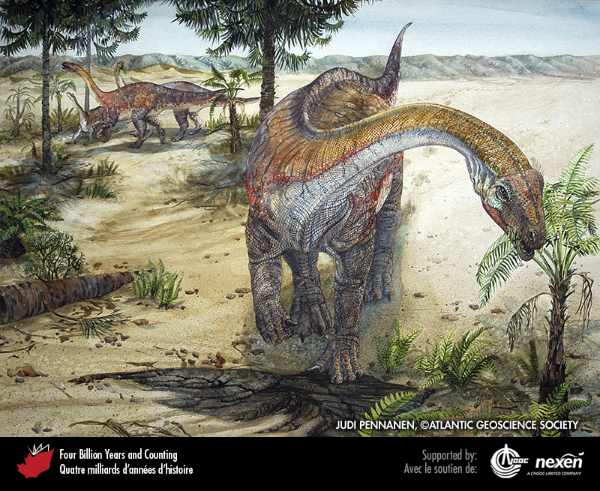
Notes:
The most famous impact (pun intended) on the fossil record of dinosaurs is the one that wiped them out at the end of the Cretaceous. Less well known is that the end-Triassic mass extinction event largely cleared the way for the great Jurassic diversification of dinosaurs, much in the way that their own demise at the end of the Cretaceous led to the Cenozoic dominance of mammals. This scene of a group of prosauropod dinosaurs is based on fossils found in earliest Jurassic sediments near Parrsboro, Nova Scotia (Chapter 9). PAINTING BY JUDI PENNANEN, COURTESY OF THE ATLANTIC GEOSCIENCE SOCIETY.
_______________________________
All photographic and graphic images (henceforth referred to as images) posted on this site are copyright of the persons and/or institutions indicated in the caption directly associated with each image. The copyright holders have agreed that you may use their images for educational, non-commercial purposes only and provided that they are credited in each instance of use. For all other uses you must contact the copyright holder.

Slide 14
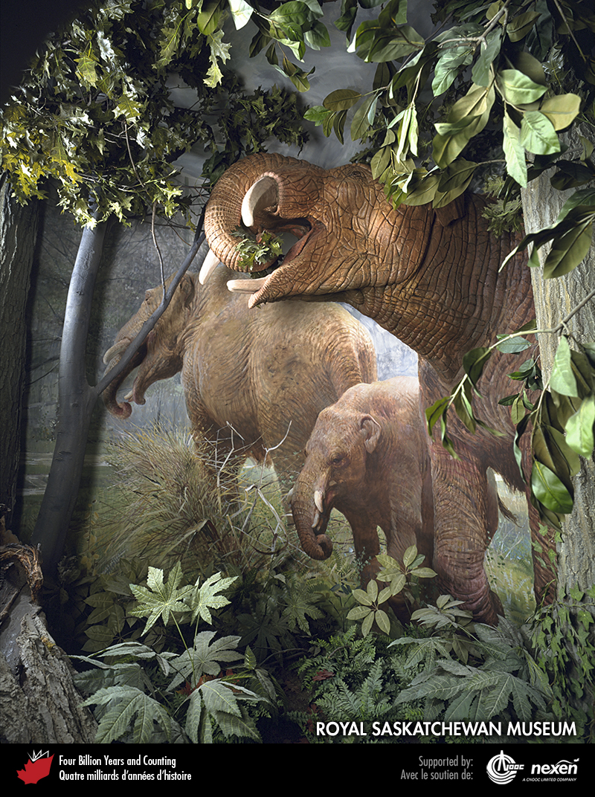
Notes:
If the Mesozoic was the age of reptiles, mammals reigned over the vertebrate world of the Cenozoic. This diorama shows a family of mastodons (Zygolophodon) in a thicket in the Rockglen area of Saskatchewan, 14 million years ago. IMAGE OF DIORAMA COURTESY OF THE ROYAL SASKATCHEWAN MUSEUM.
_______________________________
All photographic and graphic images (henceforth referred to as images) posted on this site are copyright of the persons and/or institutions indicated in the caption directly associated with each image. The copyright holders have agreed that you may use their images for educational, non-commercial purposes only and provided that they are credited in each instance of use. For all other uses you must contact the copyright holder.

Slide 15
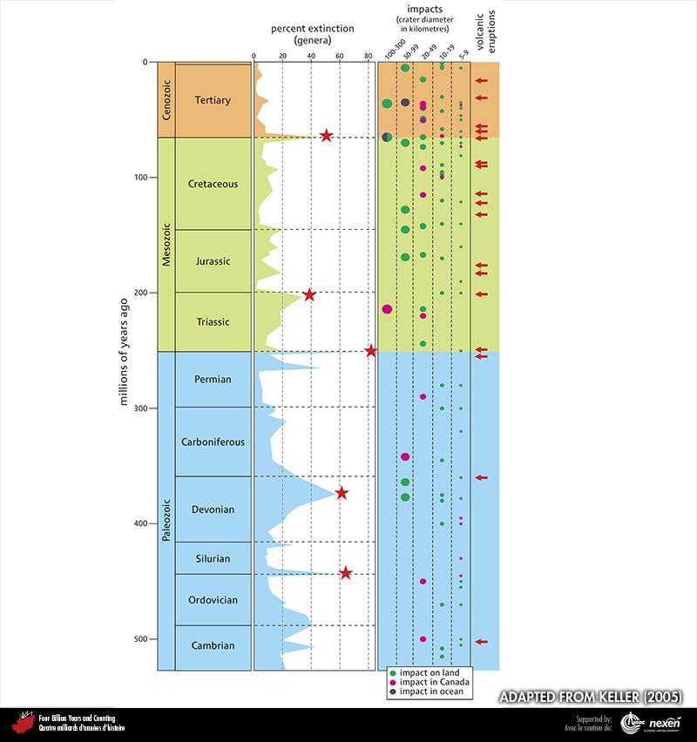
Notes:
Chart comparing the timing of extinctions with that of extraterrestrial impact structures and major volcanic episodes over the past 542 million years. The column labelled “percent extinction (genera)” also shows (with red stars) the traditionally recognized five major Phanerozoic mass-extinction events. However, as can be seen, other peaks might have comparable claims. The column labelled “impacts” shows the frequency and size of major impact events in Earth history, and whether the bodies plunged into Canada, other countries, or the ocean. As no oceanic crust is older than about 180 million years, all records of impacts in the ocean prior to that time have been lost. Significant episodes of volcanic eruptions are shown in the column to the far right. ADAPTED FROM KELLER (2005), USED WITH PERMISSION OF THE AUTHOR AND THE AUSTRALIAN JOURNAL OF EARTH SCIENCES.
_______________________________
All photographic and graphic images (henceforth referred to as images) posted on this site are copyright of the persons and/or institutions indicated in the caption directly associated with each image. The copyright holders have agreed that you may use their images for educational, non-commercial purposes only and provided that they are credited in each instance of use. For all other uses you must contact the copyright holder.

