Slide 1
CHAPTER 7 Part 4 of 4
All photographic and graphic images (henceforth referred to as images) posted on this site are copyright of the persons and/or institutions indicated in the caption directly associated with each image. The copyright holders have agreed that you may use their images for educational, non-commercial purposes only and provided that they are credited in each instance of use. For all other uses you must contact the copyright holder.

Slide 2
Notes:
Earliest Cambrian quartz-rich sandstone beds in a road cut on the Trans-Canada Highway west of Golden, British Columbia. These beds overlie the Purcell Thrust, which carried Neoproterozoic and mostly non-calcareous, deep-water early Paleozoic strata eastward over early Paleozoic calcareous shale and carbonate. JIM MONGER.
_______________________________
All photographic and graphic images (henceforth referred to as images) posted on this site are copyright of the persons and/or institutions indicated in the caption directly associated with each image. The copyright holders have agreed that you may use their images for educational, non-commercial purposes only and provided that they are credited in each instance of use. For all other uses you must contact the copyright holder.

Slide 3
Notes:
Folded Cambrian calcareous shale in the Solitude Range of the Columbia Mountains, about 100 kilometres northwest of Golden, British Columbia. LEN GAL.
_______________________________
All photographic and graphic images (henceforth referred to as images) posted on this site are copyright of the persons and/or institutions indicated in the caption directly associated with each image. The copyright holders have agreed that you may use their images for educational, non-commercial purposes only and provided that they are credited in each instance of use. For all other uses you must contact the copyright holder.

Slide 4
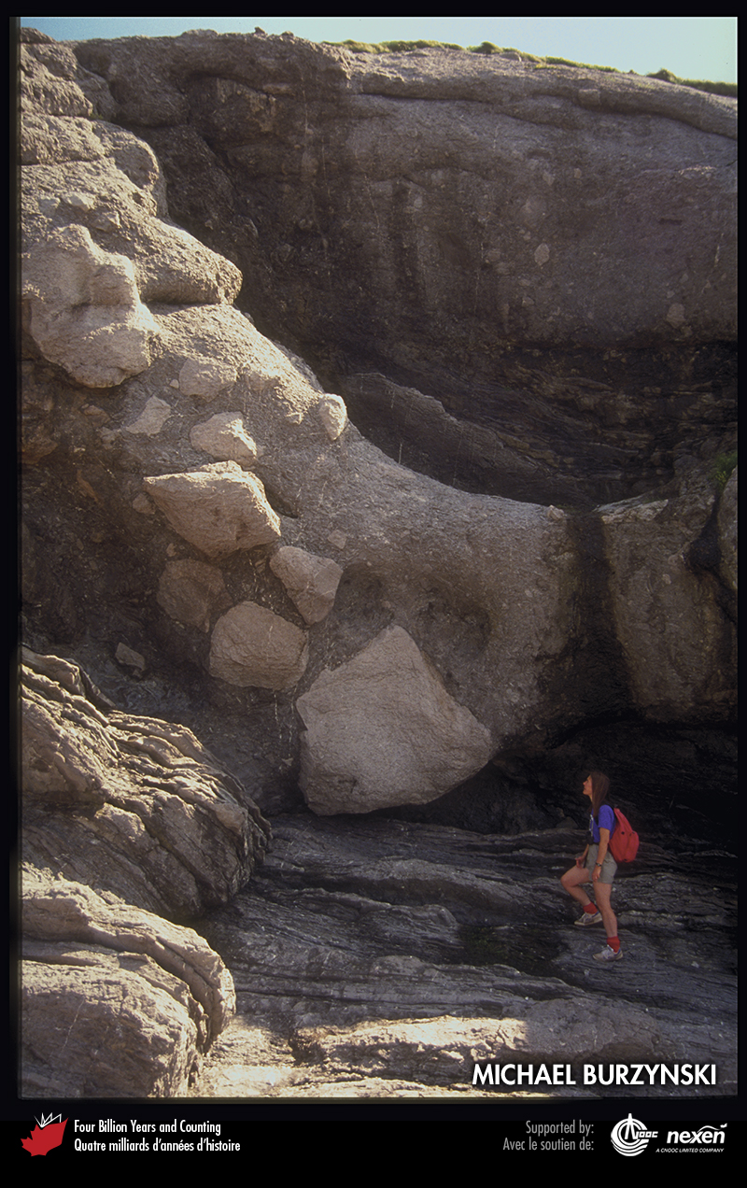
Notes:
Early Ordovician breccia at Cow Head, Newfoundland, originally a debris flow at the edge of a carbonate bank on the Laurentian margin. The debris flow may have been triggered by earthquakes associated with the Taconic Orogeny. MICHAEL BURZYNSKI.
_______________________________
All photographic and graphic images (henceforth referred to as images) posted on this site are copyright of the persons and/or institutions indicated in the caption directly associated with each image. The copyright holders have agreed that you may use their images for educational, non-commercial purposes only and provided that they are credited in each instance of use. For all other uses you must contact the copyright holder.

Slide 5
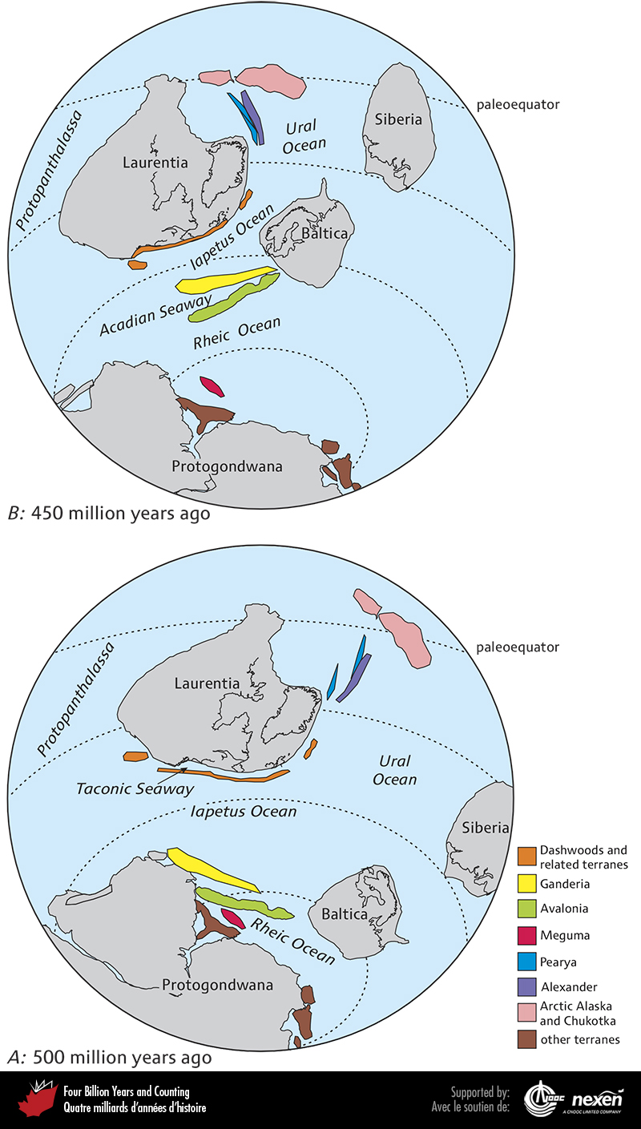
Notes:
Global paleogeography, from a paleosouthern perspective, of the late Cambrian, 500 million years ago (A), and of the late Ordovician, 450 million years ago (B). The northern part of Laurentia straddles the paleoequator in both figures. In A, the Dashwoods Microcontinent is immediately off southern Laurentia, but a narrow remnant of the Taconic Seaway remains. Ganderia and Avalonia lie immediately to the north of Protogondwana in high southern latitudes. The two terranes are separated from Laurentia by the broad Iapetus Ocean and from Protogondwana by the developing Rheic Ocean. Meguma and adjacent terranes are still close to or attached to Protogondwana. Protopanthalassa, the Ural Ocean, and Iapetus surround Laurentia. In B, the Taconic Seaway has closed and the Dashwoods Microcontinent has accreted to the southern margin of Laurentia. Fast approaching Laurentia from the south are Ganderia and Avalonia, reflecting the rapid closing of Iapetus and the widening Rheic Ocean. Meguma, which now forms part of Nova Scotia, and adjacent terranes, which now form parts of western Europe, are still close to or attached to Protogondwana. Also shown in A and B are the possible positions of Pearya and the Alexander Terrane. ADAPTED FROM VARIOUS SOURCES.
_______________________________
All photographic and graphic images (henceforth referred to as images) posted on this site are copyright of the persons and/or institutions indicated in the caption directly associated with each image. The copyright holders have agreed that you may use their images for educational, non-commercial purposes only and provided that they are credited in each instance of use. For all other uses you must contact the copyright holder.

Slide 6
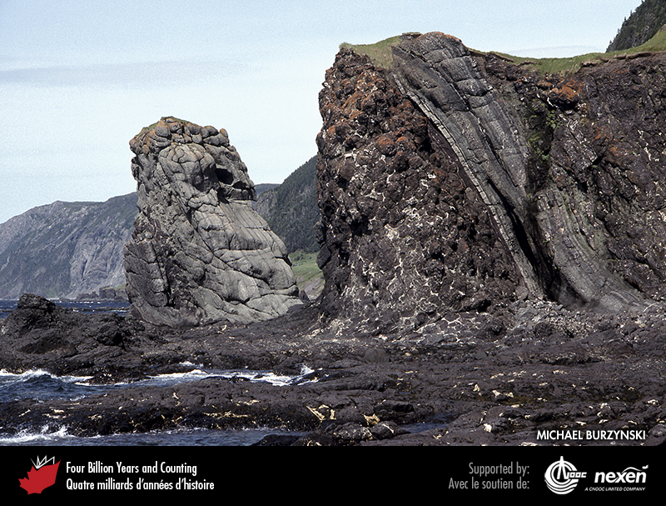
Notes:
Tilted 550-million-year-old pillow lavas and overlying strata at Green Gardens, near Gros Morne National Park of Canada, western Newfoundland. The tilting occurred during the Taconic Orogeny. MICHAEL BURZYNSKI.
_______________________________
All photographic and graphic images (henceforth referred to as images) posted on this site are copyright of the persons and/or institutions indicated in the caption directly associated with each image. The copyright holders have agreed that you may use their images for educational, non-commercial purposes only and provided that they are credited in each instance of use. For all other uses you must contact the copyright holder.

Slide 7
Notes:
This sequence of early Cambrian turbidites, at chutes-de-la-Chaudière, Charny, Quebec, was deposited on the continental slope off Laurentia. Thin mudstone layers separate sandstone beds. The beds were thrust toward the continent and tilted during the Taconic Orogeny. Note the person at bottom left for scale. ROB FENSOME.
_______________________________
All photographic and graphic images (henceforth referred to as images) posted on this site are copyright of the persons and/or institutions indicated in the caption directly associated with each image. The copyright holders have agreed that you may use their images for educational, non-commercial purposes only and provided that they are credited in each instance of use. For all other uses you must contact the copyright holder.

Slide 8
Notes:
Early to middle Ordovician metavolcanic rocks of the Tetagouche-Exploits Basin, on the banks of the Nepisiguit River, south of Bathurst, New Brunswick. ROB FENSOME.
_______________________________
All photographic and graphic images (henceforth referred to as images) posted on this site are copyright of the persons and/or institutions indicated in the caption directly associated with each image. The copyright holders have agreed that you may use their images for educational, non-commercial purposes only and provided that they are credited in each instance of use. For all other uses you must contact the copyright holder.

Slide 9
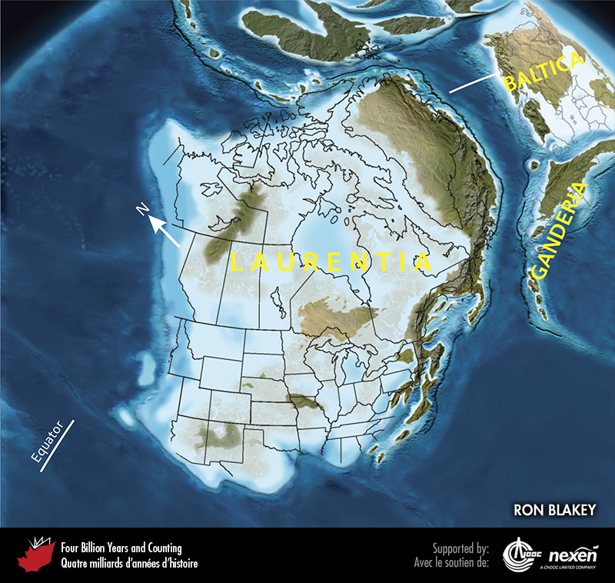
Notes:
Paleogeography of what was to become North America and adjacent regions in the middle Ordovician, 450 million years ago. Land is shown in green and brown, with shading showing topography. The lighter blue areas represent possible coastal or nearshore areas, darker blue represents deeper ocean waters, and black indicates trenches. Aspects of modern geography are shown for orientation.
_______________________________
All photographic and graphic images (henceforth referred to as images) posted on this site are copyright of the persons and/or institutions indicated in the caption directly associated with each image. The copyright holders have agreed that you may use their images for educational, non-commercial purposes only and provided that they are credited in each instance of use. For all other uses you must contact the copyright holder.

Slide 10
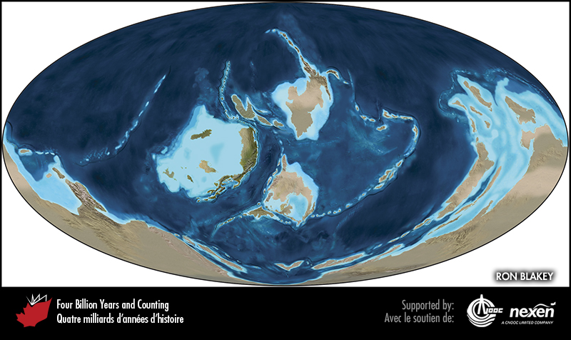
Notes:
Global paleogeography 450 million years ago, during the late Ordovician. Colours as for previous figure.
_______________________________
All photographic and graphic images (henceforth referred to as images) posted on this site are copyright of the persons and/or institutions indicated in the caption directly associated with each image. The copyright holders have agreed that you may use their images for educational, non-commercial purposes only and provided that they are credited in each instance of use. For all other uses you must contact the copyright holder.

Slide 11
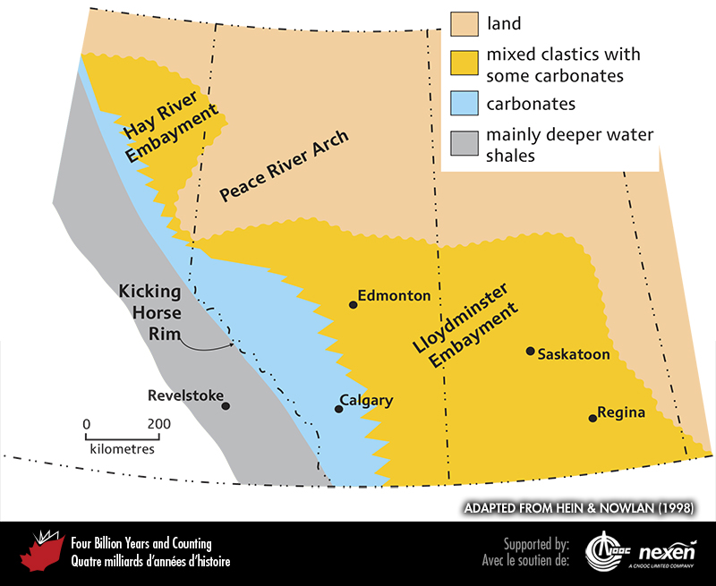
Notes:
Present distribution of Cambrian and Ordovician strata in the southern Canadian Western Interior and major features that influenced their deposition. Note that the rocks reflect a general trend from shallower to deeper water in a modern southwesterly direction. ADAPTED FROM HEIN AND NOWLAN (1998).
_______________________________
All photographic and graphic images (henceforth referred to as images) posted on this site are copyright of the persons and/or institutions indicated in the caption directly associated with each image. The copyright holders have agreed that you may use their images for educational, non-commercial purposes only and provided that they are credited in each instance of use. For all other uses you must contact the copyright holder.

Slide 12
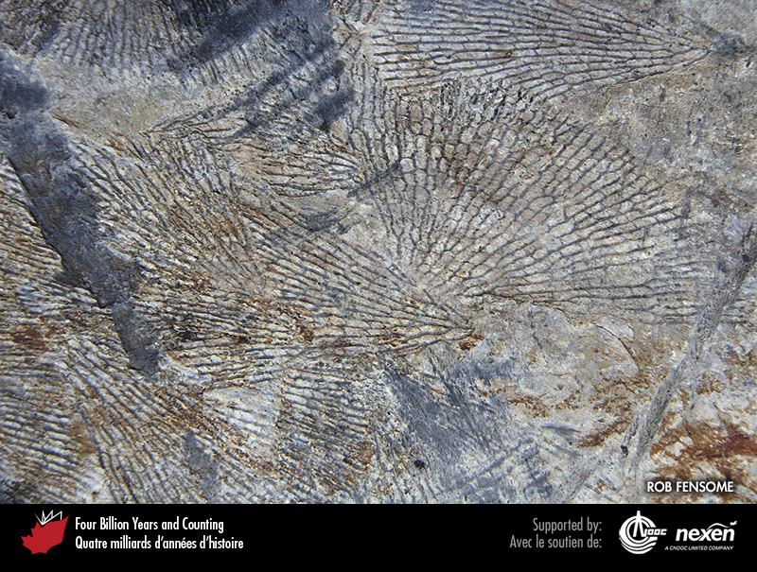
Notes:
Specimens of the graptolite Rhabdinopora flabelliforme on an early Ordovician bedding surface in Meguma Terrane rocks near Wolfville, Nova Scotia. ROB FENSOME, SPECIMEN COURTESY OF CHRIS WHITE.
_______________________________
All photographic and graphic images (henceforth referred to as images) posted on this site are copyright of the persons and/or institutions indicated in the caption directly associated with each image. The copyright holders have agreed that you may use their images for educational, non-commercial purposes only and provided that they are credited in each instance of use. For all other uses you must contact the copyright holder.

Slide 13
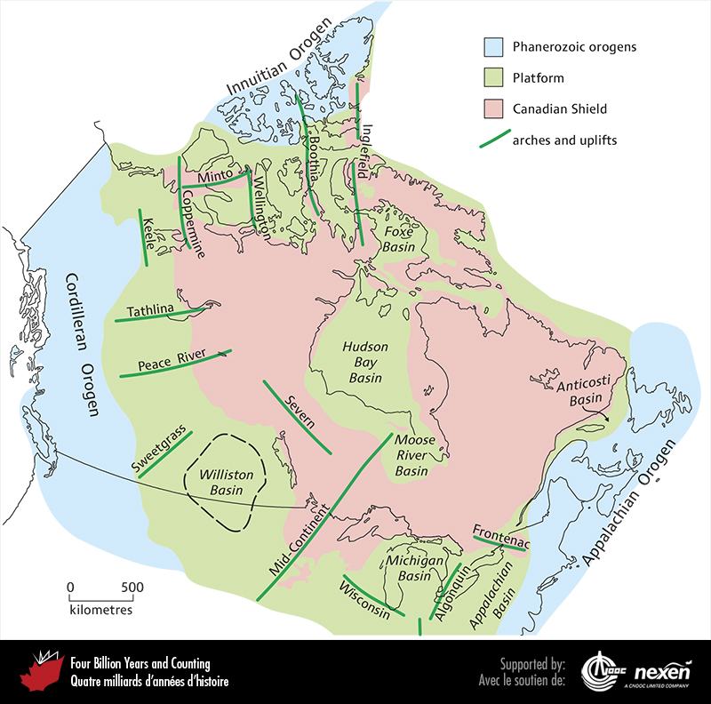
Notes:
Major upward flexures (arches) and downward flexures (basins) in the lithosphere of the continental interior that persisted through much of the Paleozoic. ADAPTED FROM VARIOUS SOURCES.
_______________________________
All photographic and graphic images (henceforth referred to as images) posted on this site are copyright of the persons and/or institutions indicated in the caption directly associated with each image. The copyright holders have agreed that you may use their images for educational, non-commercial purposes only and provided that they are credited in each instance of use. For all other uses you must contact the copyright holder.

Slide 14
Notes:
Aerial view of the shoreline of Hudson Bay, near Churchill, Manitoba. The boulders are embedded in Ordovician carbonate and are remnants of the ancient shoreline of an island within the late Ordovician continental sea covering Laurentia. Paleoproterozoic metasandstone deposited in the Trans-Hudson Orogen was the source of the boulders. GRAHAM YOUNG.
_______________________________
All photographic and graphic images (henceforth referred to as images) posted on this site are copyright of the persons and/or institutions indicated in the caption directly associated with each image. The copyright holders have agreed that you may use their images for educational, non-commercial purposes only and provided that they are credited in each instance of use. For all other uses you must contact the copyright holder.

Slide 15
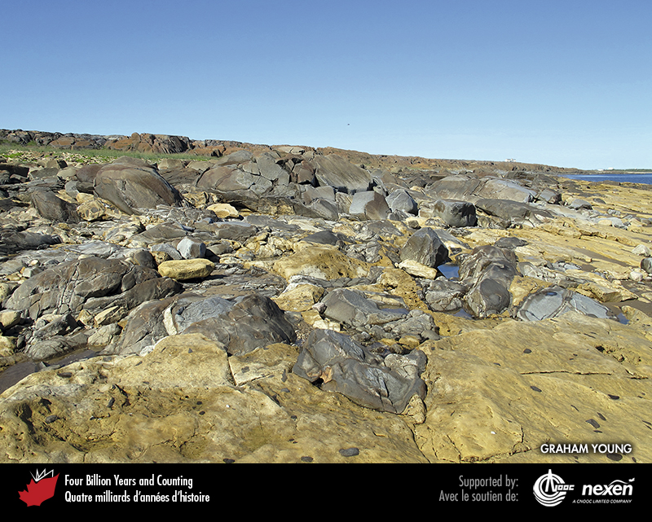
Notes:
Close-up of the rocks shown in the previous photo. GRAHAM YOUNG.
_______________________________
All photographic and graphic images (henceforth referred to as images) posted on this site are copyright of the persons and/or institutions indicated in the caption directly associated with each image. The copyright holders have agreed that you may use their images for educational, non-commercial purposes only and provided that they are credited in each instance of use. For all other uses you must contact the copyright holder.

Slide 16
Notes:
Nautiloid in a polished slab of Ordovician Tyndall Stone from Garson, Manitoba. GRAHAM YOUNG.
_______________________________
All photographic and graphic images (henceforth referred to as images) posted on this site are copyright of the persons and/or institutions indicated in the caption directly associated with each image. The copyright holders have agreed that you may use their images for educational, non-commercial purposes only and provided that they are credited in each instance of use. For all other uses you must contact the copyright holder.

Slide 17
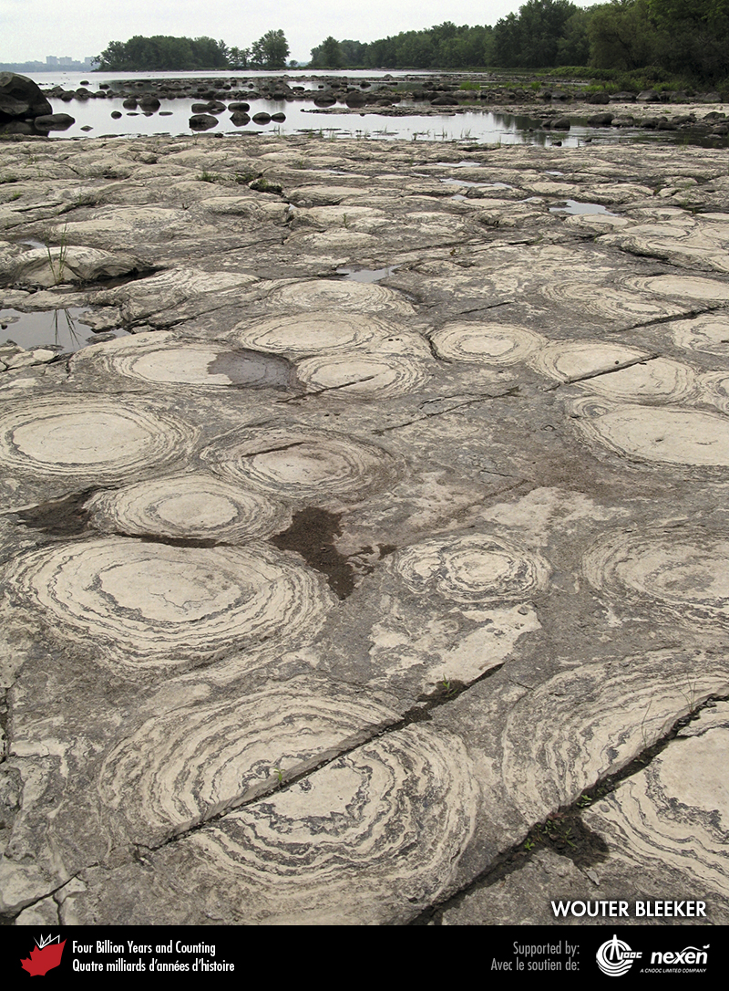
Notes:
These late Ordovician carbonates with impressive stromatolites can be seen at low water levels near the Quebec shore of the Ottawa River, Gatineau, Quebec. Much of Laurentia was covered by a continental sea during the late Ordovician. WOUTER BLEEKER.
_______________________________
All photographic and graphic images (henceforth referred to as images) posted on this site are copyright of the persons and/or institutions indicated in the caption directly associated with each image. The copyright holders have agreed that you may use their images for educational, non-commercial purposes only and provided that they are credited in each instance of use. For all other uses you must contact the copyright holder.

Slide 18
Notes:
Black shales within a sequence of clastics and carbonates marking the Ordovician-Silurian boundary on Ellesmere Island, Nunavut. The boundary is probably at the base of the thickest band of black shale. MIKE MELCHIN.
_______________________________
All photographic and graphic images (henceforth referred to as images) posted on this site are copyright of the persons and/or institutions indicated in the caption directly associated with each image. The copyright holders have agreed that you may use their images for educational, non-commercial purposes only and provided that they are credited in each instance of use. For all other uses you must contact the copyright holder.

