Slide 1
CHAPTER 19
All photographic and graphic images (henceforth referred to as images) posted on this site are copyright of the persons and/or institutions indicated in the caption directly associated with each image. The copyright holders have agreed that you may use their images for educational, non-commercial purposes only and provided that they are credited in each instance of use. For all other uses you must contact the copyright holder.

Slide 2
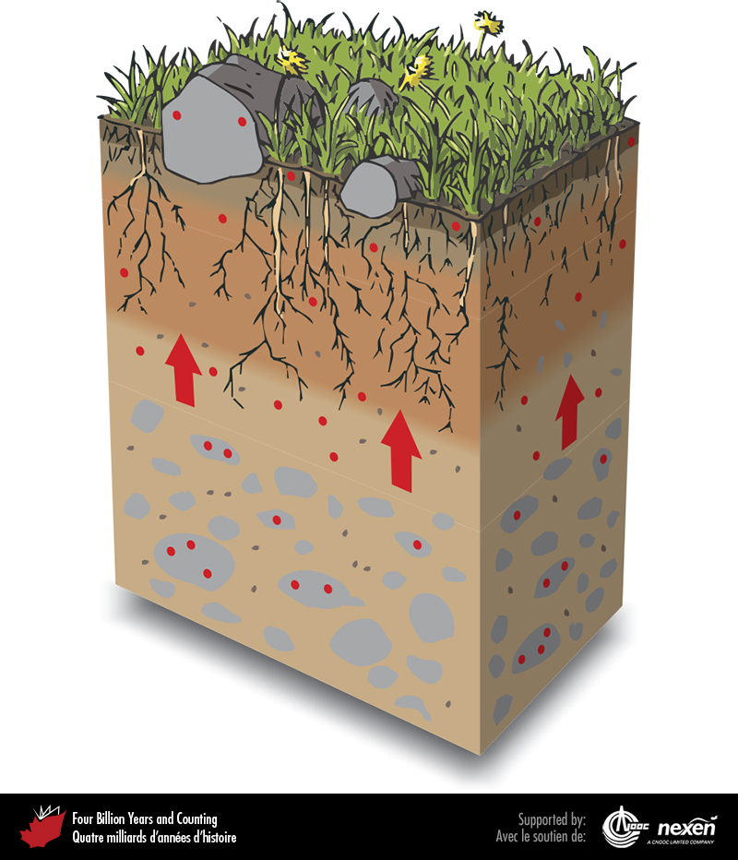
Notes:
Profile of a soil derived from till. Natural weathering processes release metals such as cadmium from rocks and minerals into the soil. The released metals (represented by red dots) may dissolve in water, or they may attach to organic particles in the soil. Metals are taken up by plants in varying amounts (a process represented by the red arrows) depending on soil conditions and plant type. The transfer of metals from geological sources to the food chain occurs when the plants are eaten by animals that in turn may be eaten by humans. ADAPTED FROM VARIOUS SOURCES.
_______________________________
All photographic and graphic images (henceforth referred to as images) posted on this site are copyright of the persons and/or institutions indicated in the caption directly associated with each image. The copyright holders have agreed that you may use their images for educational, non-commercial purposes only and provided that they are credited in each instance of use. For all other uses you must contact the copyright holder.

Slide 3
Notes:
Scientists use chambers to measure natural mercury vapour emissions. At this site on Paleozoic black shale in the Macmillan Pass area, Yukon, mercury vapour is released to the atmosphere at a rate of about 9 nanograms per square metre per hour during the summer. ALEXANDRA STEFFEN.
_______________________________
All photographic and graphic images (henceforth referred to as images) posted on this site are copyright of the persons and/or institutions indicated in the caption directly associated with each image. The copyright holders have agreed that you may use their images for educational, non-commercial purposes only and provided that they are credited in each instance of use. For all other uses you must contact the copyright holder.

Slide 4
Notes:
The Rove Shale, a Paleoproterozoic rock extracted from numerous small quarries west of Thunder Bay, Ontario, is used extensively as aggregate for constructing rural roads and as fill. Emissions of mercury from the Rove Shale enter the atmosphere at a daytime rate of about 32 nanograms per square metre per hour in the summer. PAT RASMUSSEN.
_______________________________
All photographic and graphic images (henceforth referred to as images) posted on this site are copyright of the persons and/or institutions indicated in the caption directly associated with each image. The copyright holders have agreed that you may use their images for educational, non-commercial purposes only and provided that they are credited in each instance of use. For all other uses you must contact the copyright holder.

Slide 5
Notes:
Testing for water quality in a stream flowing into Sherbrooke Lake, Lunenburg County, Nova Scotia. ROB FENSOME.
_______________________________
All photographic and graphic images (henceforth referred to as images) posted on this site are copyright of the persons and/or institutions indicated in the caption directly associated with each image. The copyright holders have agreed that you may use their images for educational, non-commercial purposes only and provided that they are credited in each instance of use. For all other uses you must contact the copyright holder.

Slide 6
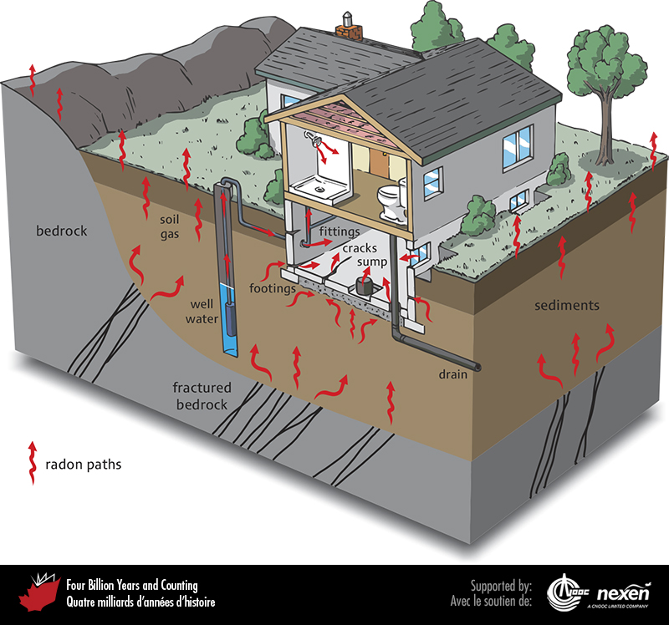
Notes:
Radon enters homes from geological sources. Radon concentrations in homes are partly influenced by the presence of uranium in bedrock and surficial deposits, and partly by characteristics of the house. Depending upon how easy is it for radon gas to enter, accumulate in, and leave a building, there can be considerable variation in the concentration of radon in homes and offices, even in the same geological setting.
_______________________________
All photographic and graphic images (henceforth referred to as images) posted on this site are copyright of the persons and/or institutions indicated in the caption directly associated with each image. The copyright holders have agreed that you may use their images for educational, non-commercial purposes only and provided that they are credited in each instance of use. For all other uses you must contact the copyright holder.

Slide 7
Notes:
Testing for radon. REPRODUCED WITH THE PERMISSION OF NATURAL RESOURCES CANADA 2013, COURTESY OF THE GEOLOGICAL SURVEY OF CANADA.
_______________________________
All photographic and graphic images (henceforth referred to as images) posted on this site are copyright of the persons and/or institutions indicated in the caption directly associated with each image. The copyright holders have agreed that you may use their images for educational, non-commercial purposes only and provided that they are credited in each instance of use. For all other uses you must contact the copyright holder.

Slide 8
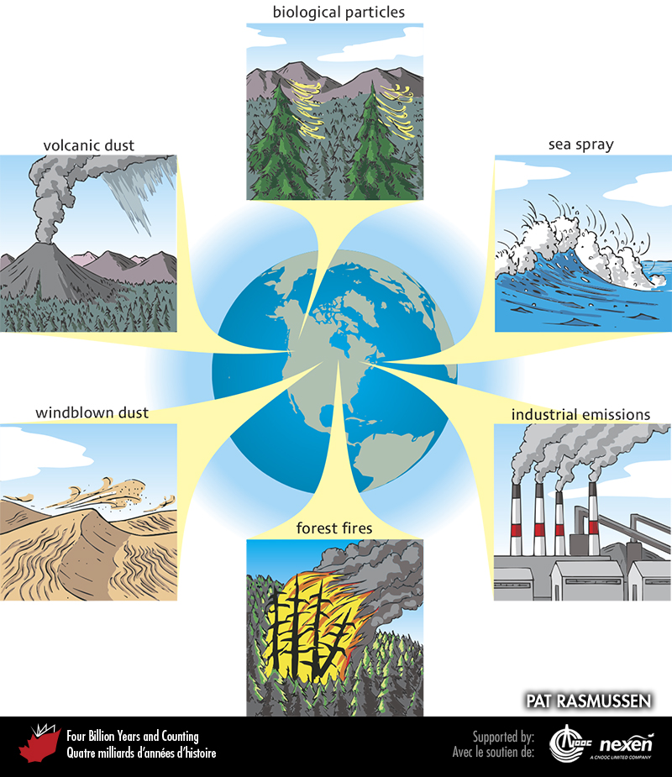
Notes:
Globally, the major sources of airborne particles are industrial, sea spray, windblown dust, volcanic dust, forest-fire debris, and biological particles (spores, pollen, waxes). Particle emission inventories indicate that industrial emissions contribute about 5 to 7 percent of total annual global emissions.
_______________________________
All photographic and graphic images (henceforth referred to as images) posted on this site are copyright of the persons and/or institutions indicated in the caption directly associated with each image. The copyright holders have agreed that you may use their images for educational, non-commercial purposes only and provided that they are credited in each instance of use. For all other uses you must contact the copyright holder.

Slide 9
Notes:
A specimen of chrysotile asbestos from Quebec. D. MARUSKA, REPRODUCED WITH THE PERMISSION OF NATURAL RESOURCES CANADA 2013, COURTESY OF THE GEOLOGICAL SURVEY OF CANADA.
_______________________________
All photographic and graphic images (henceforth referred to as images) posted on this site are copyright of the persons and/or institutions indicated in the caption directly associated with each image. The copyright holders have agreed that you may use their images for educational, non-commercial purposes only and provided that they are credited in each instance of use. For all other uses you must contact the copyright holder.

Slide 10
Notes:
Urban residential dirt (soil, street dust, and house dust) can contain some unpleasant substances such as lead and smelly organic compounds. DAVID GARDNER.
_______________________________
All photographic and graphic images (henceforth referred to as images) posted on this site are copyright of the persons and/or institutions indicated in the caption directly associated with each image. The copyright holders have agreed that you may use their images for educational, non-commercial purposes only and provided that they are credited in each instance of use. For all other uses you must contact the copyright holder.

