Slide 1
CHAPTER 20 Part 2 of 3
All photographic and graphic images (henceforth referred to as images) posted on this site are copyright of the persons and/or institutions indicated in the caption directly associated with each image. The copyright holders have agreed that you may use their images for educational, non-commercial purposes only and provided that they are credited in each instance of use. For all other uses you must contact the copyright holder.

Slide 2
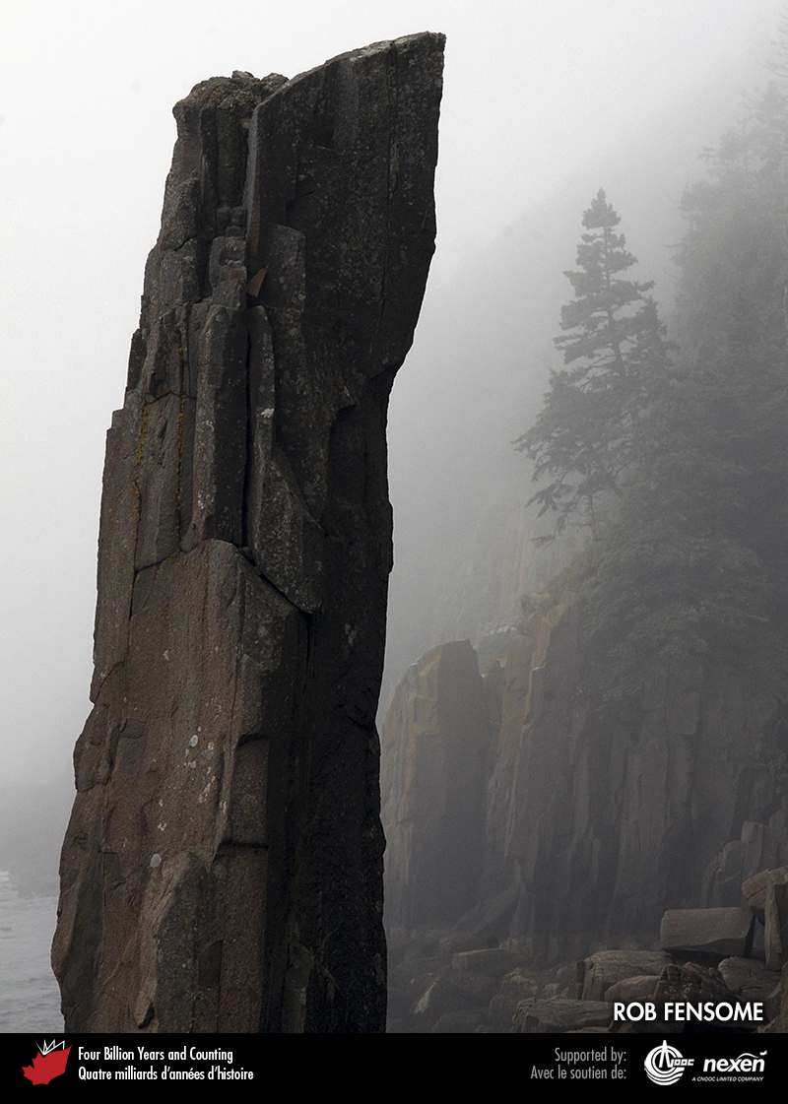
Notes:
Balancing Rock is a pillar of North Mountain Basalt on Long Island, Nova Scotia. The North Mountain Basalt is part of an episode of late Triassic magmatic activity that presaged the breakup of Pangea and the opening of the Atlantic Ocean. ROB FENSOME. _______________________________
All photographic and graphic images (henceforth referred to as images) posted on this site are copyright of the persons and/or institutions indicated in the caption directly associated with each image. The copyright holders have agreed that you may use their images for educational, non-commercial purposes only and provided that they are credited in each instance of use. For all other uses you must contact the copyright holder.

Slide 3
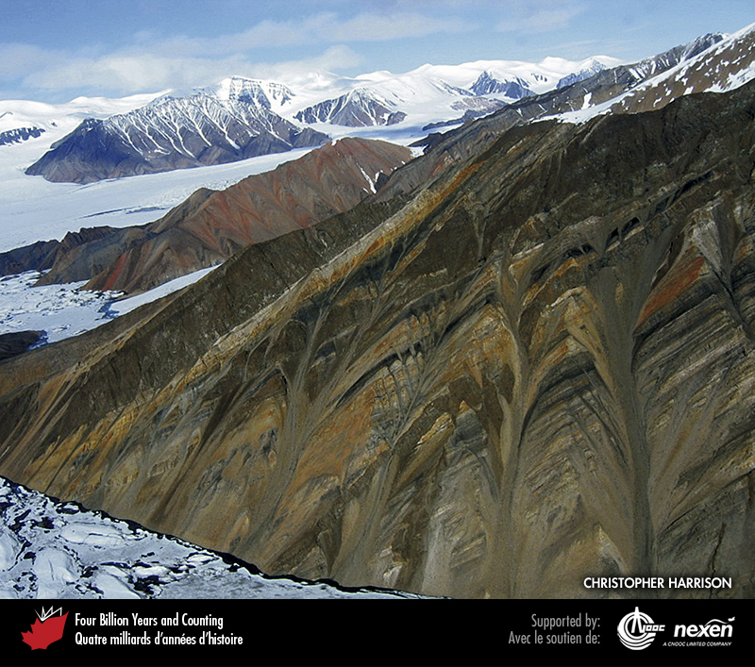
Notes:
The black bands in this cliff east of Thompson Glacier on Axel Heiberg Island, Nunavut, are early Cretaceous mafic sills. Here they intrude between late Triassic sandstone and shale layers. The sills are part of the magmatic activity that heralded the early development of the Arctic Ocean. CHRISTOPHER HARRISON.
_______________________________
All photographic and graphic images (henceforth referred to as images) posted on this site are copyright of the persons and/or institutions indicated in the caption directly associated with each image. The copyright holders have agreed that you may use their images for educational, non-commercial purposes only and provided that they are credited in each instance of use. For all other uses you must contact the copyright holder.

Slide 4
Notes:
Conglomerate of Tertiary age, Cypress Hills, southwestern Saskatchewan. FLOYD WIST.
_______________________________
All photographic and graphic images (henceforth referred to as images) posted on this site are copyright of the persons and/or institutions indicated in the caption directly associated with each image. The copyright holders have agreed that you may use their images for educational, non-commercial purposes only and provided that they are credited in each instance of use. For all other uses you must contact the copyright holder.

Slide 5
Notes:
Glacial erosion produced a lot of sediment, material that came to be deposited widely as till. This landscape in southeastern Alberta is formed of hummocky till deposited by the Laurentide Ice Sheet. ROB FENSOME.
_______________________________
All photographic and graphic images (henceforth referred to as images) posted on this site are copyright of the persons and/or institutions indicated in the caption directly associated with each image. The copyright holders have agreed that you may use their images for educational, non-commercial purposes only and provided that they are credited in each instance of use. For all other uses you must contact the copyright holder.

Slide 6
Notes:
Stromatolites in red dolostone within a small Mesoproterozoic basin on northern Somerset Island, Nunavut. Stromatolites resulted from the activity of microbes and are widespread in Proterozoic sedimentary rocks prior to the evolution of grazing animals. The red colour here is due to oxidation during diagenesis of small amounts of iron in the dolostone. DARREL LONG.
_______________________________
All photographic and graphic images (henceforth referred to as images) posted on this site are copyright of the persons and/or institutions indicated in the caption directly associated with each image. The copyright holders have agreed that you may use their images for educational, non-commercial purposes only and provided that they are credited in each instance of use. For all other uses you must contact the copyright holder.

Slide 7
Notes:
Psammichnites gigas, an early Cambrian trace fossil from Hanford Brook, New Brunswick. The explosion of life from 580 to 530 million years ago, saw not only a spectacular rise in the variety of animal body fossils but also a burgeoning of trace fossils. HEINZ WIELE, COURTESY OF THE ATLANTIC GEOSCIENCE SOCIETY; SPECIMEN COURTESY OF THE NEW BRUNSWICK MUSEUM.
_______________________________
All photographic and graphic images (henceforth referred to as images) posted on this site are copyright of the persons and/or institutions indicated in the caption directly associated with each image. The copyright holders have agreed that you may use their images for educational, non-commercial purposes only and provided that they are credited in each instance of use. For all other uses you must contact the copyright holder.

Slide 8
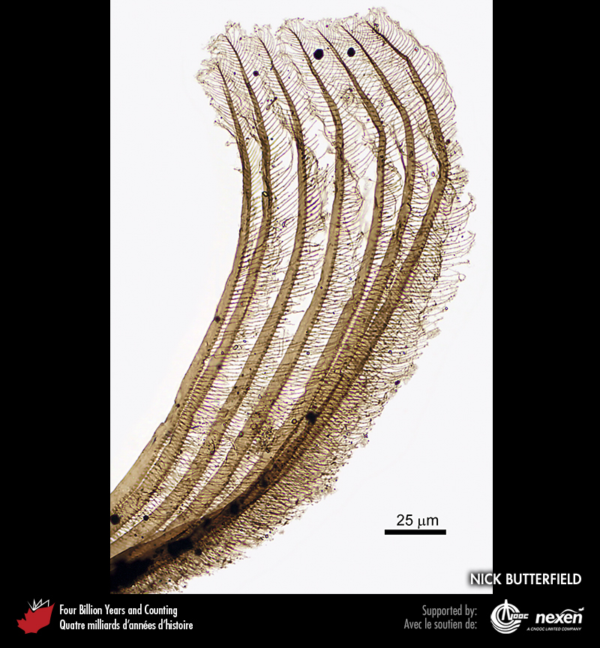
Notes:
Partially intact filtration structure of a shrimp-like crustacean from early Cambrian rocks in the Northwest Territories. The specimen is about two-tenths of a millimetre long. It reflects the increasing complexity and diversity of life at the time. NICK BUTTERFIELD.
_______________________________
All photographic and graphic images (henceforth referred to as images) posted on this site are copyright of the persons and/or institutions indicated in the caption directly associated with each image. The copyright holders have agreed that you may use their images for educational, non-commercial purposes only and provided that they are credited in each instance of use. For all other uses you must contact the copyright holder.

Slide 9
Notes:
Abundant fossils are exposed on this early Silurian bedding surface from Anticosti Island, Quebec. During the Ordovician and Silurian, invertebrates proliferated in the oceans, where almost all life was then located. ROB FENSOME, SPECIMEN COURTESY OF NATURAL RESOURCES CANADA AND PAUL COPPER.
_______________________________
All photographic and graphic images (henceforth referred to as images) posted on this site are copyright of the persons and/or institutions indicated in the caption directly associated with each image. The copyright holders have agreed that you may use their images for educational, non-commercial purposes only and provided that they are credited in each instance of use. For all other uses you must contact the copyright holder.

Slide 10
Notes:
A specimen of the arthropod Belinurus from middle Carboniferous rocks near Parrsboro, Nova Scotia. ANDREW MACRAE.
_______________________________
All photographic and graphic images (henceforth referred to as images) posted on this site are copyright of the persons and/or institutions indicated in the caption directly associated with each image. The copyright holders have agreed that you may use their images for educational, non-commercial purposes only and provided that they are credited in each instance of use. For all other uses you must contact the copyright holder.

Slide 11
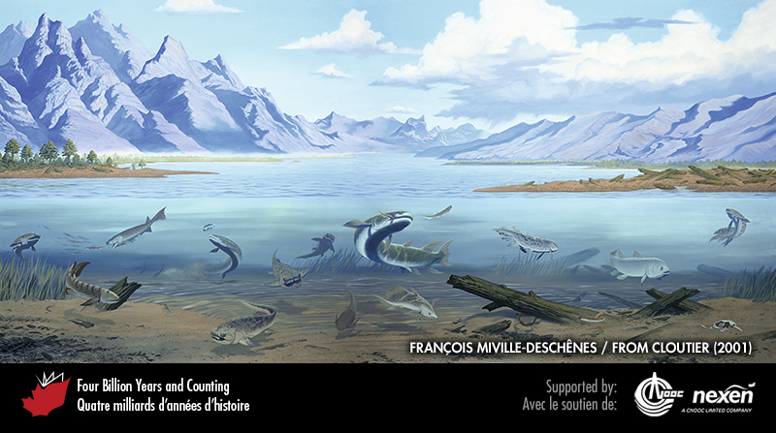
Notes:
In this Devonian estuary scene, the underwater fauna is dominated by fish, based on fossils found at Miguasha, on Chaleur Bay in Quebec. The waters of the estuary have as their backdrop the eroding Acadian Mountains, part of the Appalachian Orogen. FROM CLOUTIER (2001), USED WITH PERMISSION; PAINTING BY FRANÇOIS MIVILLE-DESCHÊNES.
_______________________________
All photographic and graphic images (henceforth referred to as images) posted on this site are copyright of the persons and/or institutions indicated in the caption directly associated with each image. The copyright holders have agreed that you may use their images for educational, non-commercial purposes only and provided that they are credited in each instance of use. For all other uses you must contact the copyright holder.

Slide 12
Notes:
Early Carboniferous amphibian footprints at Blue Beach, Nova Scotia. HEINZ WIELE, COURTESY OF THE ATLANTIC GEOSCIENCE SOCIETY; SPECIMEN COURTESY OF GORDON OAKEY.
_______________________________
All photographic and graphic images (henceforth referred to as images) posted on this site are copyright of the persons and/or institutions indicated in the caption directly associated with each image. The copyright holders have agreed that you may use their images for educational, non-commercial purposes only and provided that they are credited in each instance of use. For all other uses you must contact the copyright holder.

Slide 13
Notes:
This strange looking middle Carboniferous rock from Parrsboro, Nova Scotia, may be a paleosol. Before life moved onto land, the Earth’s surface was largely either bare or loose rubble, as on Mars today. Plants and, later, animals provided the organic component and the mechanisms needed to produce soil and, hence, fertile land. ROB FENSOME.
_______________________________
All photographic and graphic images (henceforth referred to as images) posted on this site are copyright of the persons and/or institutions indicated in the caption directly associated with each image. The copyright holders have agreed that you may use their images for educational, non-commercial purposes only and provided that they are credited in each instance of use. For all other uses you must contact the copyright holder.

Slide 14
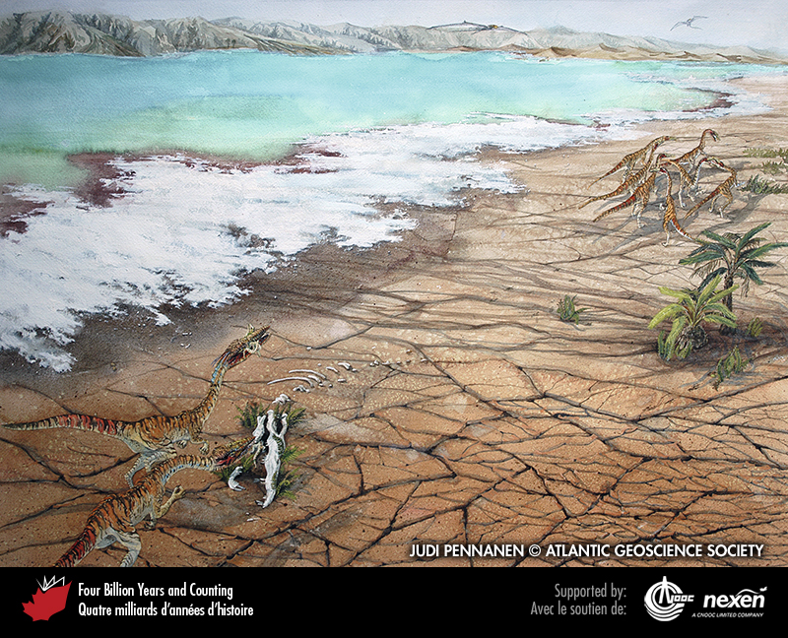
Notes:
In this latest Triassic scene based in part on fossil finds around the Bay of Fundy in Nova Scotia, a pair of Coelophysis dinosaurs pause by a phytosaur skeleton as the main pack forges ahead. Early pterosaurs soar overhead. The mud-cracked surface and evaporite deposits (white) bordering the lake testify to a hot, dry climate. But the remains of the phytosaur, an animal that lived in wetter environments, testifies to fluctuating climatic conditions in the region during the late Triassic. PAINTING BY JUDI PENNANEN, COURTESY OF THE ATLANTIC GEOSCIENCE SOCIETY.
_______________________________
All photographic and graphic images (henceforth referred to as images) posted on this site are copyright of the persons and/or institutions indicated in the caption directly associated with each image. The copyright holders have agreed that you may use their images for educational, non-commercial purposes only and provided that they are credited in each instance of use. For all other uses you must contact the copyright holder.

Slide 15
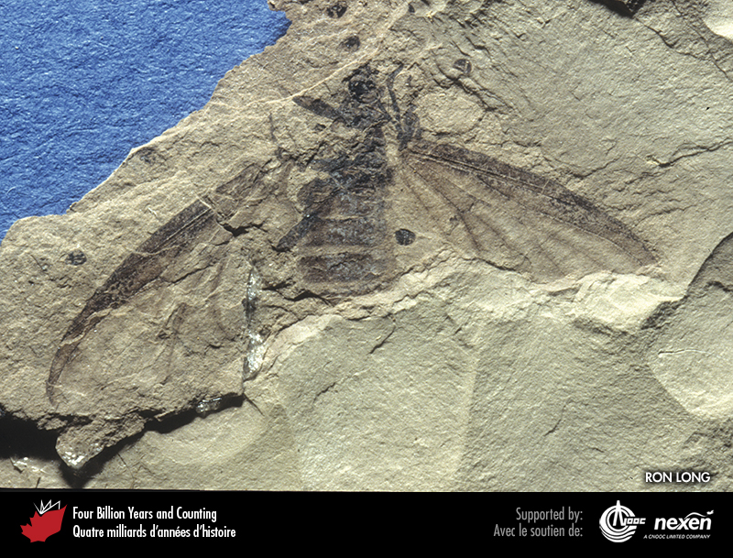
Notes:
March fly from Eocene lake deposits at Quilchena, British Columbia. Although they originated in the Devonian, insects have achieved incredible diversity over the past 100 million years by co-evolving with flowering plants. RON LONG.
_______________________________
All photographic and graphic images (henceforth referred to as images) posted on this site are copyright of the persons and/or institutions indicated in the caption directly associated with each image. The copyright holders have agreed that you may use their images for educational, non-commercial purposes only and provided that they are credited in each instance of use. For all other uses you must contact the copyright holder.

