Slide 1
CHAPTER 20 Part 3 of 3
All photographic and graphic images (henceforth referred to as images) posted on this site are copyright of the persons and/or institutions indicated in the caption directly associated with each image. The copyright holders have agreed that you may use their images for educational, non-commercial purposes only and provided that they are credited in each instance of use. For all other uses you must contact the copyright holder.

Slide 2
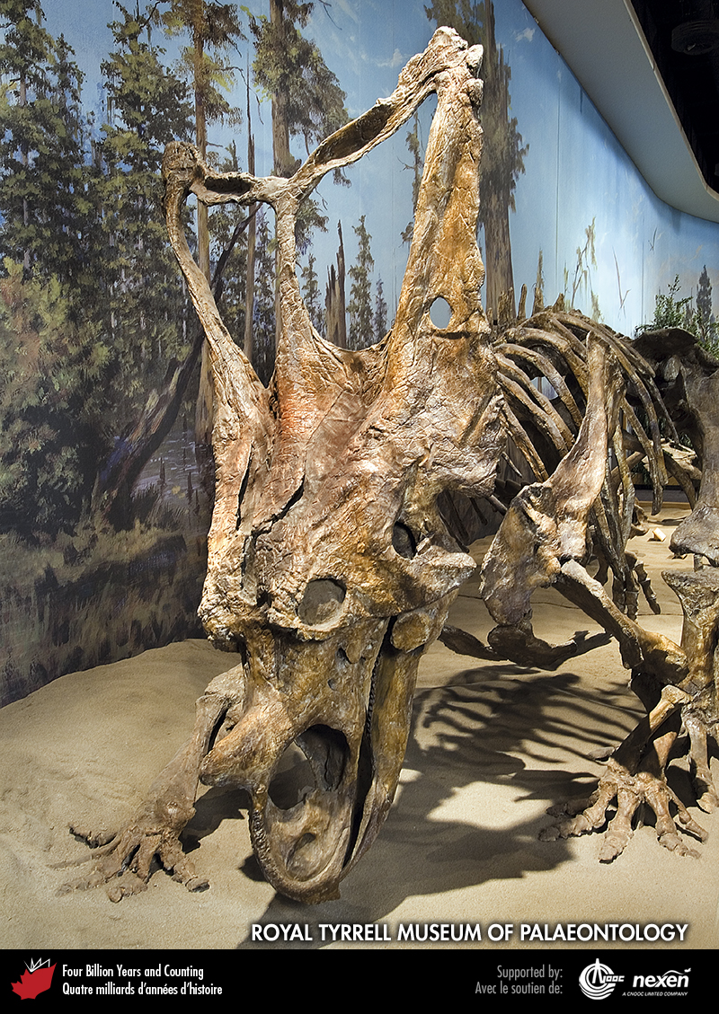
Notes:
A skeleton of Chasmosaurus, a ceratopsian dinosaur from Alberta, now on display at the Royal Tyrrell Museum of Palaeontology, Drumheller, Alberta. Some of the finest late Cretaceous dinosaurs have been discovered in rocks of the western Canadian Prairies. COURTESY OF THE ROYAL TYRRELL MUSEUM OF PALAEONTOLOGY.
_______________________________
All photographic and graphic images (henceforth referred to as images) posted on this site are copyright of the persons and/or institutions indicated in the caption directly associated with each image. The copyright holders have agreed that you may use their images for educational, non-commercial purposes only and provided that they are credited in each instance of use. For all other uses you must contact the copyright holder.

Slide 3
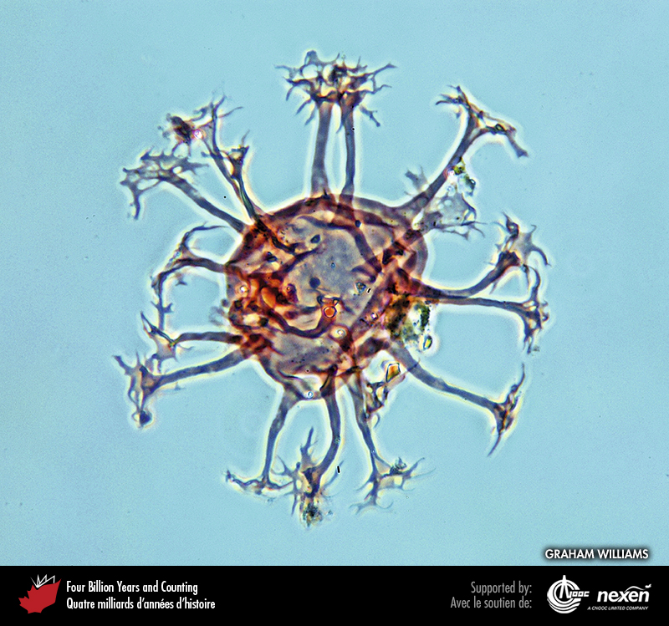
Notes:
Stained specimen of the dinoflagellate Oligosphaeridium from late Cretaceous rocks of a shallow core hole in Baffin Bay. Plankton, such as coccolithophores, diatoms, dinoflagellates, and planktonic foraminifera, evolved during the early Mesozoic. GRAHAM WILLIAMS.
_______________________________
All photographic and graphic images (henceforth referred to as images) posted on this site are copyright of the persons and/or institutions indicated in the caption directly associated with each image. The copyright holders have agreed that you may use their images for educational, non-commercial purposes only and provided that they are credited in each instance of use. For all other uses you must contact the copyright holder.

Slide 4
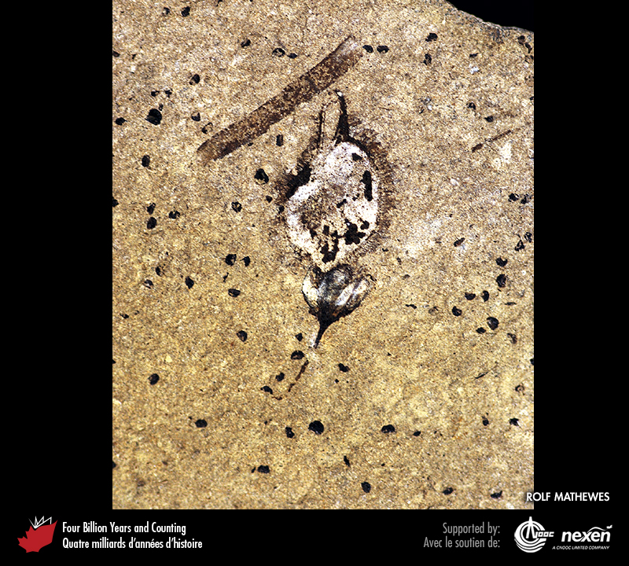
Notes:
Specimen of the fruit of an elm tree preserved in Eocene lake deposits at Quilchena, British Columbia. Flowering plants (angiosperms) evolved in the early Cretaceous and have since developed a dominant role in land-based ecosystems. ROLF MATHEWES.
_______________________________
All photographic and graphic images (henceforth referred to as images) posted on this site are copyright of the persons and/or institutions indicated in the caption directly associated with each image. The copyright holders have agreed that you may use their images for educational, non-commercial purposes only and provided that they are credited in each instance of use. For all other uses you must contact the copyright holder.

Slide 5
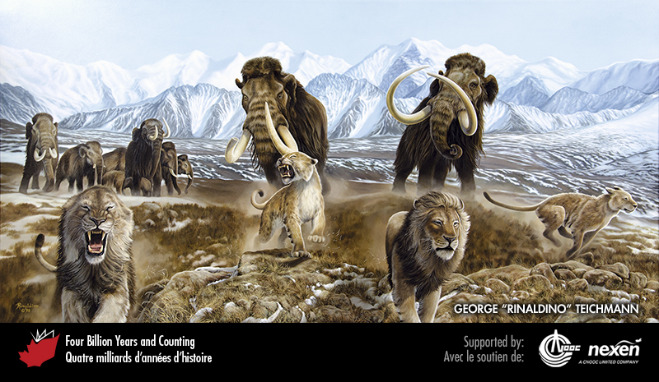
Notes:
In this Quaternary Beringian scene, cave lions retreat from a herd of mammoth. SHAMEFUL RETREAT BY GEORGE “RINALDINO” TEICHMANN, COPYRIGHT 1998.
_______________________________
All photographic and graphic images (henceforth referred to as images) posted on this site are copyright of the persons and/or institutions indicated in the caption directly associated with each image. The copyright holders have agreed that you may use their images for educational, non-commercial purposes only and provided that they are credited in each instance of use. For all other uses you must contact the copyright holder.

Slide 6
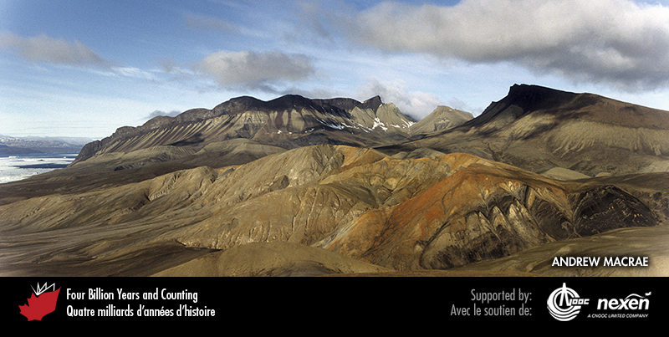
Notes:
Aerial view of Split Mountain, western Axel Heiberg Island, Nunavut. Resistant, gently folded Cretaceous basalt flows form cliffs several hundred metres high. Beneath the basalts are early Cretaceous mudstone and sandstone. The hills in the foreground are formed of diapirs of yellowish-grey Carboniferous gypsum and salt, whose injection caused the doming up of the Cretaceous rocks. ANDREW MACRAE.
_______________________________
All photographic and graphic images (henceforth referred to as images) posted on this site are copyright of the persons and/or institutions indicated in the caption directly associated with each image. The copyright holders have agreed that you may use their images for educational, non-commercial purposes only and provided that they are credited in each instance of use. For all other uses you must contact the copyright holder.

Slide 7
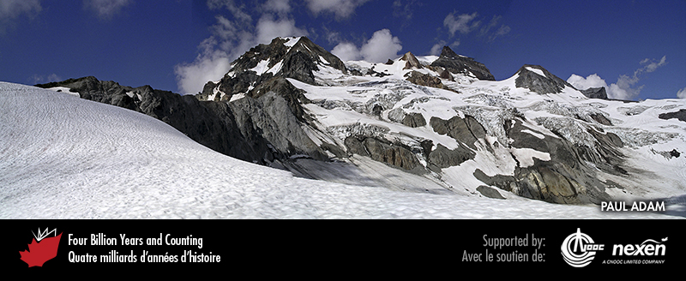
Notes:
Mount Garibaldi, British Columbia, was built from eruptions over the past 200 thousand years. The volcano last erupted about 12,000 years ago. Canada’s only potentially active volcanoes are all in the far west. PAUL ADAM.
_______________________________
All photographic and graphic images (henceforth referred to as images) posted on this site are copyright of the persons and/or institutions indicated in the caption directly associated with each image. The copyright holders have agreed that you may use their images for educational, non-commercial purposes only and provided that they are credited in each instance of use. For all other uses you must contact the copyright holder.

Slide 8
Notes:
Farwell Canyon, British Columbia, where glacial outwash and glacial lake sediments have been eroded into cliffs and pillars. PAUL ADAM.
_______________________________
All photographic and graphic images (henceforth referred to as images) posted on this site are copyright of the persons and/or institutions indicated in the caption directly associated with each image. The copyright holders have agreed that you may use their images for educational, non-commercial purposes only and provided that they are credited in each instance of use. For all other uses you must contact the copyright holder.

Slide 9
Notes:
The Rocky Mountains may be Canada’s best-known landscape. Part of the range is a UNESCO World Heritage Site. Although they do not reach the heights of the Coast and St. Elias Mountains, the Rocky Mountains attract and inspire many visitors; they were the first recognized and are the best studied of all thrust-and-fold belts. This view is of the Kananaskis Country of Alberta. RON GARNETT / AIRSCAPES.CA.
_______________________________
All photographic and graphic images (henceforth referred to as images) posted on this site are copyright of the persons and/or institutions indicated in the caption directly associated with each image. The copyright holders have agreed that you may use their images for educational, non-commercial purposes only and provided that they are credited in each instance of use. For all other uses you must contact the copyright holder.

Slide 10
Notes:
The Red River meanders across the flat Prairie landscape in this view northward between Letellier and St. Jean Baptiste, Manitoba. GREG BROOKS.
_______________________________
All photographic and graphic images (henceforth referred to as images) posted on this site are copyright of the persons and/or institutions indicated in the caption directly associated with each image. The copyright holders have agreed that you may use their images for educational, non-commercial purposes only and provided that they are credited in each instance of use. For all other uses you must contact the copyright holder.

Slide 11
Notes:
Aerial view of the Canadian Shield at Lefty’s Falls on the Grease River, northwest of Stony Rapids, Saskatchewan. RON GARNETT / AIRSCAPES.CA.
_______________________________
All photographic and graphic images (henceforth referred to as images) posted on this site are copyright of the persons and/or institutions indicated in the caption directly associated with each image. The copyright holders have agreed that you may use their images for educational, non-commercial purposes only and provided that they are credited in each instance of use. For all other uses you must contact the copyright holder.

Slide 12
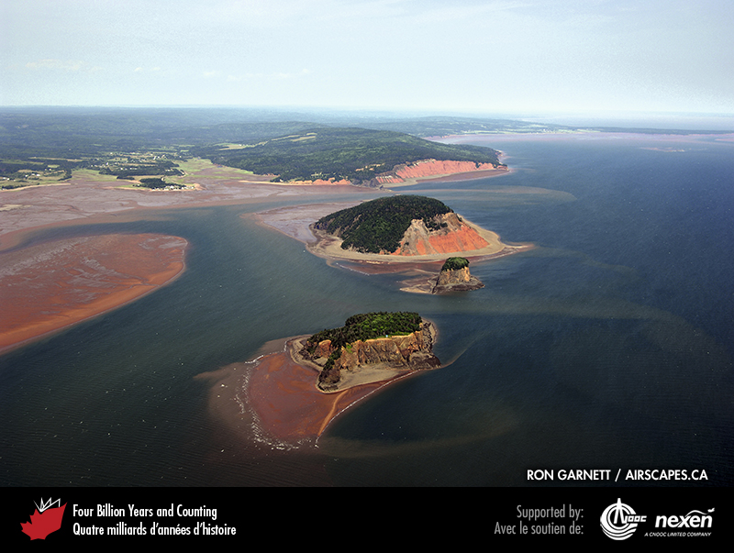
Notes:
Bay of Fundy shoreline at Five Islands, Nova Scotia. Mi’kmaw tradition says that the native god Glooscap created these islands when he threw chunks of sod at a wizard who was mocking his powers; the wizard turned himself into a giant beaver to escape. RON GARNETT / AIRSCAPES.CA.
_______________________________
All photographic and graphic images (henceforth referred to as images) posted on this site are copyright of the persons and/or institutions indicated in the caption directly associated with each image. The copyright holders have agreed that you may use their images for educational, non-commercial purposes only and provided that they are credited in each instance of use. For all other uses you must contact the copyright holder.

Slide 13
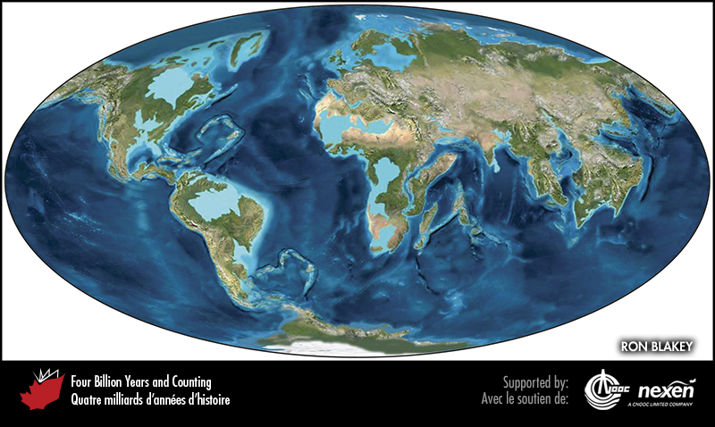
Notes:
Global paleogeography 50 million years into the future. The lighter blue areas represent possible coastal or nearshore areas, darker blue represents deeper ocean waters, and black indicates trenches. RON BLAKEY.
_______________________________
All photographic and graphic images (henceforth referred to as images) posted on this site are copyright of the persons and/or institutions indicated in the caption directly associated with each image. The copyright holders have agreed that you may use their images for educational, non-commercial purposes only and provided that they are credited in each instance of use. For all other uses you must contact the copyright holder.

Slide 14
Notes:
This fall scene of Lake Bouchard in La Mauricie National Park of Canada, Quebec, is typical of much of southern Ontario and Quebec. M. MILLS, COPYRIGHT PARKS CANADA.
_______________________________
All photographic and graphic images (henceforth referred to as images) posted on this site are copyright of the persons and/or institutions indicated in the caption directly associated with each image. The copyright holders have agreed that you may use their images for educational, non-commercial purposes only and provided that they are credited in each instance of use. For all other uses you must contact the copyright holder.

Slide 15
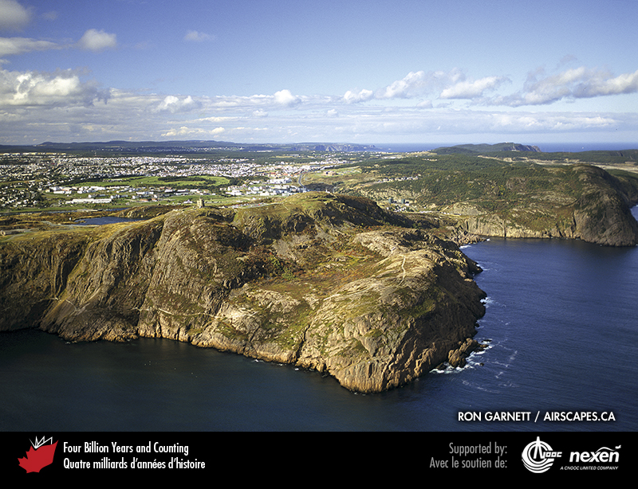
Notes:
Aerial view of Signal Hill in St. John’s, Newfoundland. The Cabot Tower, at the top of the cliffs at left, is constructed in part from the local Ediacaran rocks that underlie the Avalon Peninsula. The Tower was built in 1898–1900 to mark the 400th anniversary of the landing of John Cabot, so this scene provides a fitting reflection on Canada’s intertwined geological and historical heritages. RON GARNETT / AIRSCAPES.CA.
_______________________________
All photographic and graphic images (henceforth referred to as images) posted on this site are copyright of the persons and/or institutions indicated in the caption directly associated with each image. The copyright holders have agreed that you may use their images for educational, non-commercial purposes only and provided that they are credited in each instance of use. For all other uses you must contact the copyright holder.

