Slide 1
CHAPTER 16 Part 1 of 3
All photographic and graphic images (henceforth referred to as images) posted on this site are copyright of the persons and/or institutions indicated in the caption directly associated with each image. The copyright holders have agreed that you may use their images for educational, non-commercial purposes only and provided that they are credited in each instance of use. For all other uses you must contact the copyright holder.

Slide 2
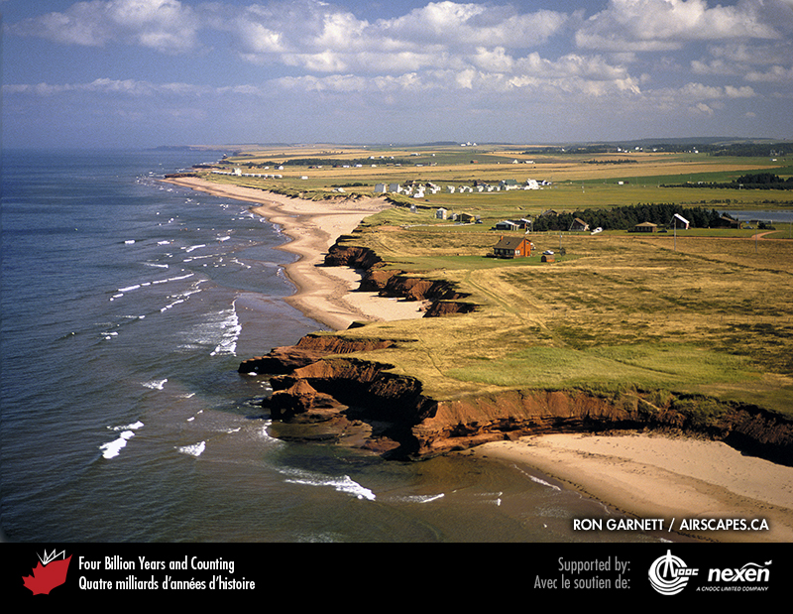
Notes:
The coastline near Lower Darnley, Prince Edward Island, consists of alternating headlands of Permian sandstone and sandy beaches backed by cliffs and dunes. RON GARNETT / AIRSCAPES.CA.
_______________________________
All photographic and graphic images (henceforth referred to as images) posted on this site are copyright of the persons and/or institutions indicated in the caption directly associated with each image. The copyright holders have agreed that you may use their images for educational, non-commercial purposes only and provided that they are credited in each instance of use. For all other uses you must contact the copyright holder.

Slide 3
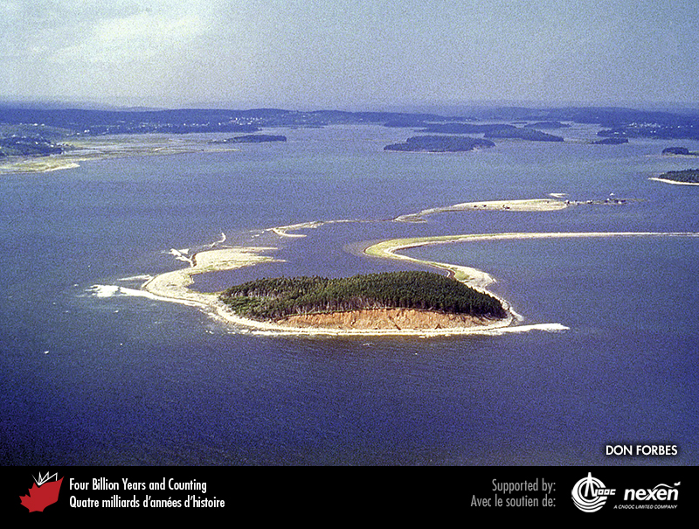
Notes:
A drumlin island at the mouth of Chezzetcook Inlet on Nova Scotia’s Eastern Shore illustrates the vulnerability of these landforms to erosion from the sea, which moves sediment to adjoining spits, beaches, and nearby bays. This 1989 aerial photo shows a spit to the left and a barrier beach to the right (the latter connecting to the mainland and formerly to Miseners Island) trailing from the drumlin. DON FORBES.
_______________________________
All photographic and graphic images (henceforth referred to as images) posted on this site are copyright of the persons and/or institutions indicated in the caption directly associated with each image. The copyright holders have agreed that you may use their images for educational, non-commercial purposes only and provided that they are credited in each instance of use. For all other uses you must contact the copyright holder.

Slide 4
Notes:
Long Beach, Pacific Rim National Park Reserve of Canada, Vancouver Island, British Columbia. T. W. HALL, COPYRIGHT PARKS CANADA.
_______________________________
All photographic and graphic images (henceforth referred to as images) posted on this site are copyright of the persons and/or institutions indicated in the caption directly associated with each image. The copyright holders have agreed that you may use their images for educational, non-commercial purposes only and provided that they are credited in each instance of use. For all other uses you must contact the copyright holder.

Slide 5
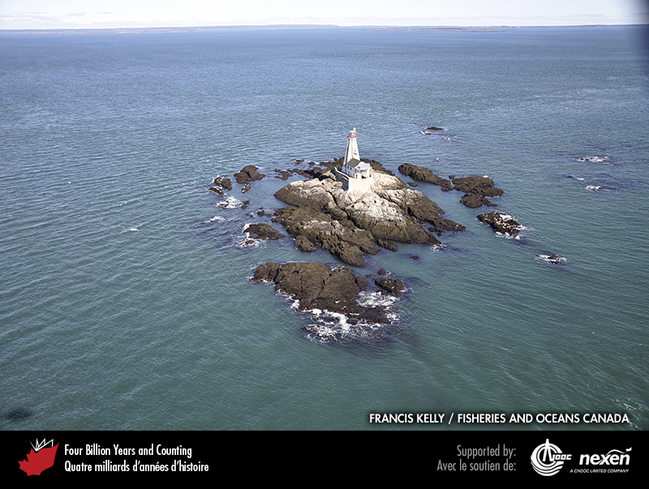
Notes:
Gannet Rock, a shoal off Grand Manan Island, New Brunswick. FRANCIS KELLY, COURTESY OF FISHERIES AND OCEANS CANADA.
_______________________________
All photographic and graphic images (henceforth referred to as images) posted on this site are copyright of the persons and/or institutions indicated in the caption directly associated with each image. The copyright holders have agreed that you may use their images for educational, non-commercial purposes only and provided that they are credited in each instance of use. For all other uses you must contact the copyright holder.

Slide 6
Notes:
Steep rock walls dominate Tingin Fiord, eastern Baffin Island, Nunavut. DON FORBES.
_______________________________
All photographic and graphic images (henceforth referred to as images) posted on this site are copyright of the persons and/or institutions indicated in the caption directly associated with each image. The copyright holders have agreed that you may use their images for educational, non-commercial purposes only and provided that they are credited in each instance of use. For all other uses you must contact the copyright holder.

Slide 7
Notes:
This cliff along the tundra shoreline at Stokes Point, Yukon, exposes massive ground ice (permafrost). Although waves undercut and erode such cliffs, warming sea temperatures are also thought to play a significant role. DON FORBES.
_______________________________
All photographic and graphic images (henceforth referred to as images) posted on this site are copyright of the persons and/or institutions indicated in the caption directly associated with each image. The copyright holders have agreed that you may use their images for educational, non-commercial purposes only and provided that they are credited in each instance of use. For all other uses you must contact the copyright holder.

Slide 8
Notes:
Melting of ice wedges and collapse of undercut blocks contributes to rapid coastal retreat along some Arctic coasts, as here at Kay Point, Yukon. DON FORBES.
_______________________________
All photographic and graphic images (henceforth referred to as images) posted on this site are copyright of the persons and/or institutions indicated in the caption directly associated with each image. The copyright holders have agreed that you may use their images for educational, non-commercial purposes only and provided that they are credited in each instance of use. For all other uses you must contact the copyright holder.

Slide 9
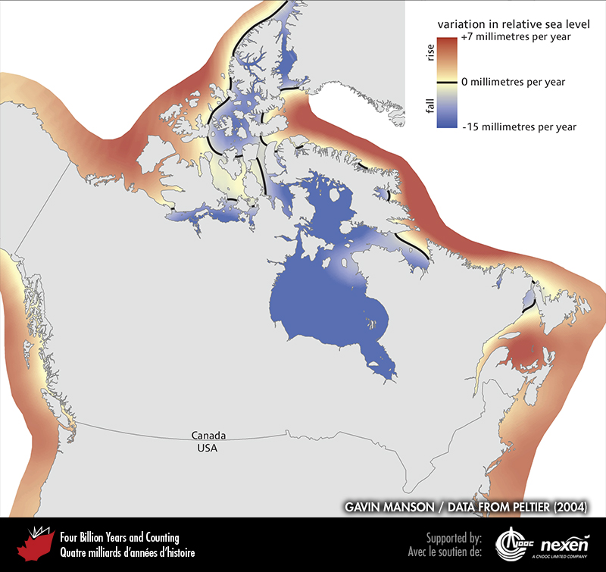
Notes:
Patterns of relative sea-level rise and fall in coastal and marine areas around northern North America. In this part of the world, relative sea-level rise or fall is controlled mostly by rise and fall of the underlying crust rather than by global sea-level changes. DATA FROM PELTIER (2004); FIGURE COMPILED BY GAVIN MANSON .
_______________________________
All photographic and graphic images (henceforth referred to as images) posted on this site are copyright of the persons and/or institutions indicated in the caption directly associated with each image. The copyright holders have agreed that you may use their images for educational, non-commercial purposes only and provided that they are credited in each instance of use. For all other uses you must contact the copyright holder.

Slide 10
Notes:
A raised beach is a former beach that is higher than today’s shoreline because of a fall in relative sea level. At Squally Point, near Apple River, Nova Scotia, sand and gravel deposited on a Holocene beach sit atop cliffs of Devonian and Carboniferous volcanic rocks. Soon after the ice retreated in this area, sea level was about 30 metres higher than at present, but fell rapidly with isostatic rebound to below today’s level, leaving this beach high and dry. Today, sea level in the area is slowly rising. RALPH STEA.
_______________________________
All photographic and graphic images (henceforth referred to as images) posted on this site are copyright of the persons and/or institutions indicated in the caption directly associated with each image. The copyright holders have agreed that you may use their images for educational, non-commercial purposes only and provided that they are credited in each instance of use. For all other uses you must contact the copyright holder.

