Slide 1
CHAPTER 15 Part 2 of 2
All photographic and graphic images (henceforth referred to as images) posted on this site are copyright of the persons and/or institutions indicated in the caption directly associated with each image. The copyright holders have agreed that you may use their images for educational, non-commercial purposes only and provided that they are credited in each instance of use. For all other uses you must contact the copyright holder.

Slide 2
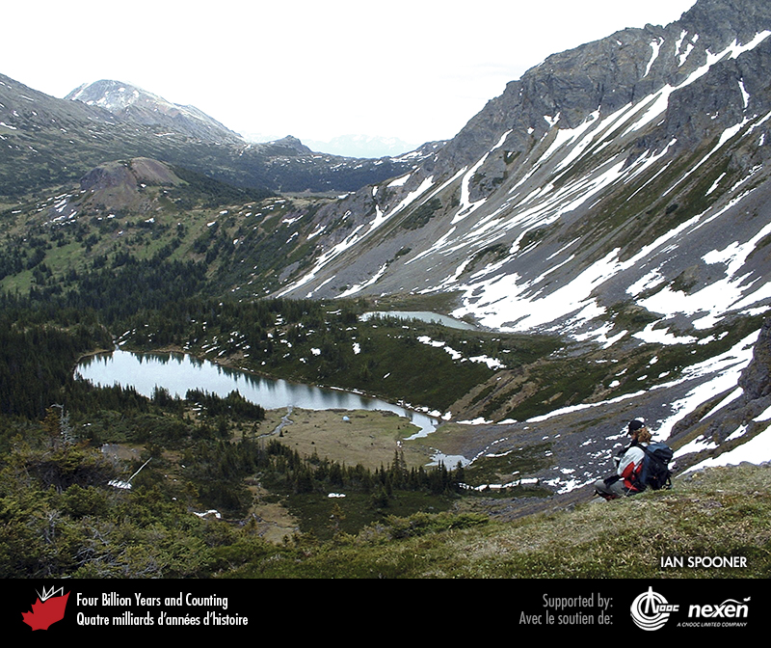
Notes:
Small upland lakes such as those shown here at Hudson Bay Mountain, near Smithers, British Columbia, demonstrate the concept of a water budget. New water inflow from rain, snowmelt, and springs is balanced by downstream water outflow and evaporation. IAN SPOONER.
_______________________________
All photographic and graphic images (henceforth referred to as images) posted on this site are copyright of the persons and/or institutions indicated in the caption directly associated with each image. The copyright holders have agreed that you may use their images for educational, non-commercial purposes only and provided that they are credited in each instance of use. For all other uses you must contact the copyright holder.

Slide 3
Notes:
Groundwater and surface water are all part of one interconnected system. Movement of water through ground and wetland environments is a natural process that reduces the contaminants in water. Peat, an especially effective filter, is excellent for storing water, which is then released slowly. The filtered water that leaves the peat has far fewer contaminants and sediment than the water that entered it. ADAPTED FROM TURNER ET AL. (2005B).
_______________________________
All photographic and graphic images (henceforth referred to as images) posted on this site are copyright of the persons and/or institutions indicated in the caption directly associated with each image. The copyright holders have agreed that you may use their images for educational, non-commercial purposes only and provided that they are credited in each instance of use. For all other uses you must contact the copyright holder.

Slide 4
Notes:
A glacier on Mount Brazeau, at the south end of Maligne Lake, Jasper National Park of Canada, Alberta. Glaciers in the Cordillera source and supply many of western and central Canada’s great rivers. ROB FENSOME.
_______________________________
All photographic and graphic images (henceforth referred to as images) posted on this site are copyright of the persons and/or institutions indicated in the caption directly associated with each image. The copyright holders have agreed that you may use their images for educational, non-commercial purposes only and provided that they are credited in each instance of use. For all other uses you must contact the copyright holder.

Slide 5
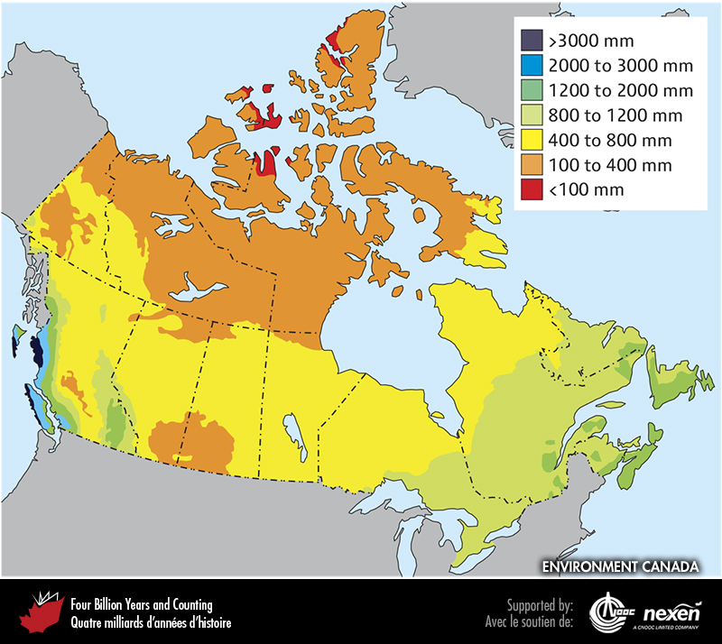
Notes:
Average annual precipitation across Canada. COURTESY OF ENVIRONMENT CANADA.
_______________________________
All photographic and graphic images (henceforth referred to as images) posted on this site are copyright of the persons and/or institutions indicated in the caption directly associated with each image. The copyright holders have agreed that you may use their images for educational, non-commercial purposes only and provided that they are credited in each instance of use. For all other uses you must contact the copyright holder.

Slide 6
Notes:
Oldman River Dam, Pincher Creek, Alberta, stores water for irrigation. RON GARNETT / AIRSCAPES.CA.
_______________________________
All photographic and graphic images (henceforth referred to as images) posted on this site are copyright of the persons and/or institutions indicated in the caption directly associated with each image. The copyright holders have agreed that you may use their images for educational, non-commercial purposes only and provided that they are credited in each instance of use. For all other uses you must contact the copyright holder.

Slide 7
Notes:
Kettle Rapids Generating Station, Gillam, Manitoba. The wide use of flowing river water to generate electricity has led to the word “hydro” being synonymous with electricity in several provinces. RON GARNETT / AIRSCAPES.CA.
_______________________________
All photographic and graphic images (henceforth referred to as images) posted on this site are copyright of the persons and/or institutions indicated in the caption directly associated with each image. The copyright holders have agreed that you may use their images for educational, non-commercial purposes only and provided that they are credited in each instance of use. For all other uses you must contact the copyright holder.

Slide 8
Notes:
Old-fashioned irrigation in the Okanagan Valley, near Oliver, British Columbia. GODFREY NOWLAN.
_______________________________
All photographic and graphic images (henceforth referred to as images) posted on this site are copyright of the persons and/or institutions indicated in the caption directly associated with each image. The copyright holders have agreed that you may use their images for educational, non-commercial purposes only and provided that they are credited in each instance of use. For all other uses you must contact the copyright holder.

Slide 9
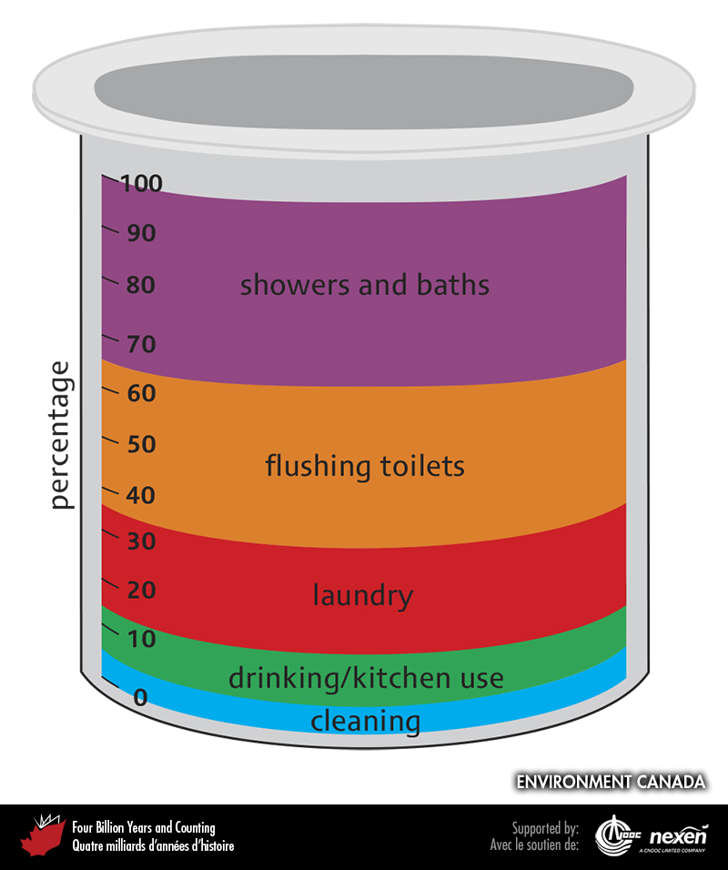
Notes:
Summary of water consumption in a typical Canadian home. ADAPTED FROM ENVIRONMENT CANADA WEBSITE.
_______________________________
All photographic and graphic images (henceforth referred to as images) posted on this site are copyright of the persons and/or institutions indicated in the caption directly associated with each image. The copyright holders have agreed that you may use their images for educational, non-commercial purposes only and provided that they are credited in each instance of use. For all other uses you must contact the copyright holder.

