Slide 1
CHAPTER 7 Part 2 of 4
All photographic and graphic images (henceforth referred to as images) posted on this site are copyright of the persons and/or institutions indicated in the caption directly associated with each image. The copyright holders have agreed that you may use their images for educational, non-commercial purposes only and provided that they are credited in each instance of use. For all other uses you must contact the copyright holder.

Slide 2
Notes:
Trace fossil known as Psammichnites gigas from earliest Cambrian rocks near St. Martins, New Brunswick. The animal that made this trace must have been a soft-bodied creature similar to a marine slug. HEINZ WIELE, COURTESY OF THE ATLANTIC GEOSCIENCE SOCIETY; SPECIMEN COURTESY OF THE NEW BRUNSWICK MUSEUM.
_______________________________
All photographic and graphic images (henceforth referred to as images) posted on this site are copyright of the persons and/or institutions indicated in the caption directly associated with each image. The copyright holders have agreed that you may use their images for educational, non-commercial purposes only and provided that they are credited in each instance of use. For all other uses you must contact the copyright holder.

Slide 3
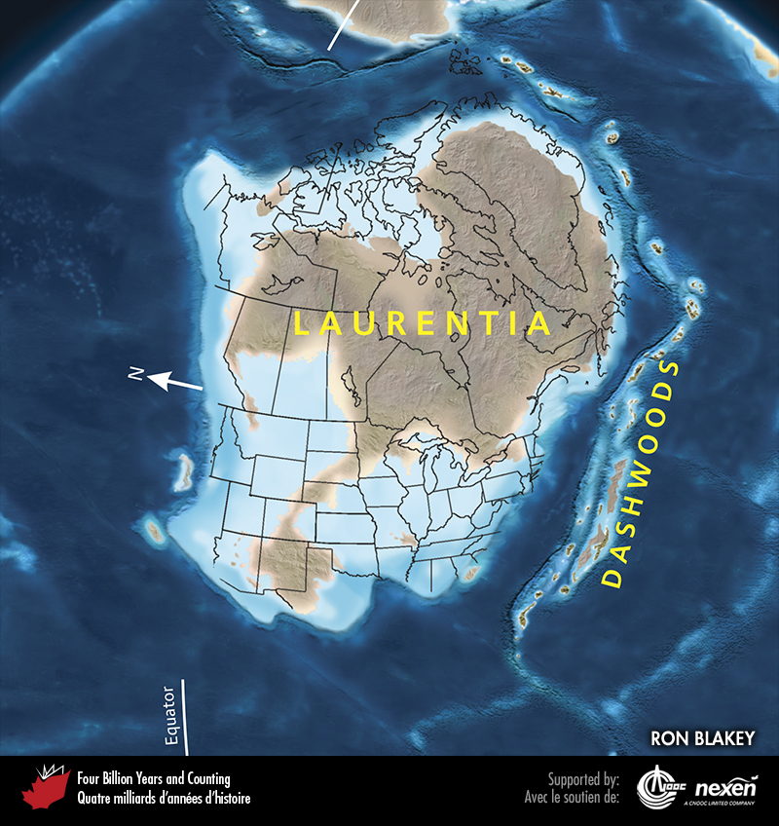
Notes:
Paleogeography of what was to become North America and adjacent regions in the Cambrian, 500 million years ago. Land is shown in brown, with shading showing topography. The lighter blue areas represent possible coastal or nearshore areas, darker blue represents deeper ocean waters, and black indicates trenches. Aspects of modern geography are shown for orientation.
_______________________________
All photographic and graphic images (henceforth referred to as images) posted on this site are copyright of the persons and/or institutions indicated in the caption directly associated with each image. The copyright holders have agreed that you may use their images for educational, non-commercial purposes only and provided that they are credited in each instance of use. For all other uses you must contact the copyright holder.

Slide 4
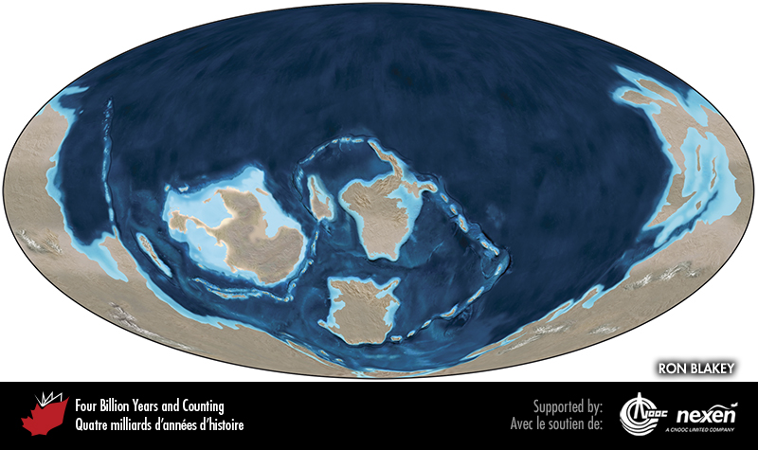
Notes:
Global paleogeography 500 million years ago, during the Cambrian. Colours as for previous figure.
_______________________________
All photographic and graphic images (henceforth referred to as images) posted on this site are copyright of the persons and/or institutions indicated in the caption directly associated with each image. The copyright holders have agreed that you may use their images for educational, non-commercial purposes only and provided that they are credited in each instance of use. For all other uses you must contact the copyright holder.

Slide 5
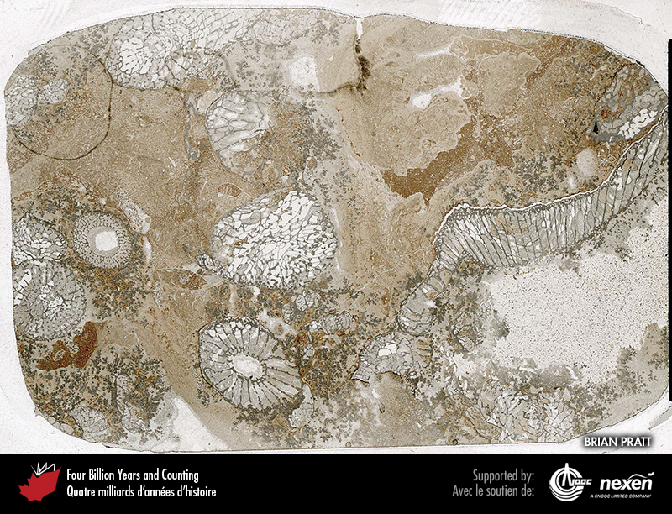
Notes:
Early Cambrian archaeocyathans encrusted with dark-grey calcite precipitated through the activity of microbes and set in a reddish mudstone, Pointe Amour, southern Labrador. BRIAN PRATT.
_______________________________
All photographic and graphic images (henceforth referred to as images) posted on this site are copyright of the persons and/or institutions indicated in the caption directly associated with each image. The copyright holders have agreed that you may use their images for educational, non-commercial purposes only and provided that they are credited in each instance of use. For all other uses you must contact the copyright holder.

Slide 6
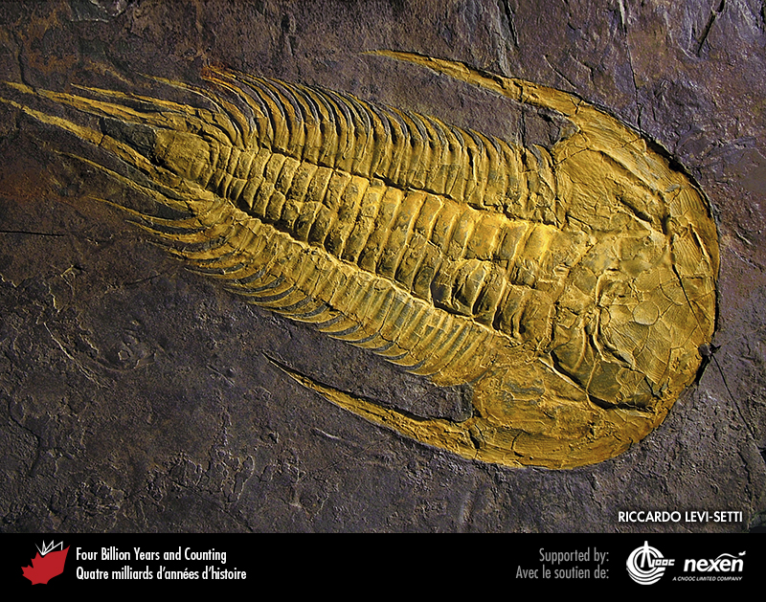
Notes:
The middle Cambrian trilobite Paradoxides davidis, from Manuels River, Newfoundland. RICCARDO LEVI-SETTI.
_______________________________
All photographic and graphic images (henceforth referred to as images) posted on this site are copyright of the persons and/or institutions indicated in the caption directly associated with each image. The copyright holders have agreed that you may use their images for educational, non-commercial purposes only and provided that they are credited in each instance of use. For all other uses you must contact the copyright holder.

Slide 7
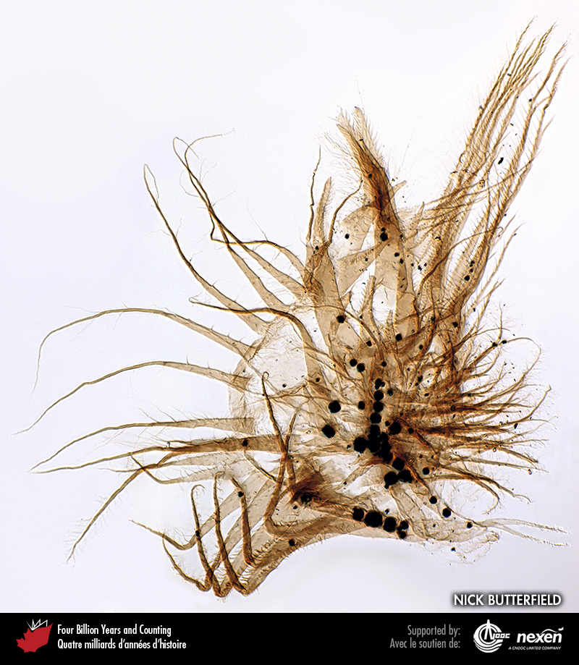
Notes:
Part of the filtration feeding structure of a branchiopod crustacean (not to be confused with brachiopods), preserved in middle Cambrian rock retrieved from a subsurface core in Saskatchewan. The specimen is about 0.15 millimetres long. NICK BUTTERFIELD.
_______________________________
All photographic and graphic images (henceforth referred to as images) posted on this site are copyright of the persons and/or institutions indicated in the caption directly associated with each image. The copyright holders have agreed that you may use their images for educational, non-commercial purposes only and provided that they are credited in each instance of use. For all other uses you must contact the copyright holder.

Slide 8
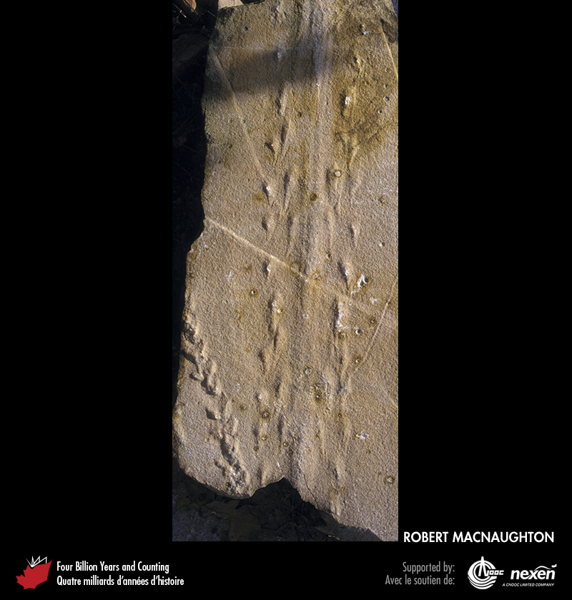
Notes:
The Cambrian trackway Protichnites from near Kingston, Ontario. ROBERT MACNAUGHTON.
_______________________________
All photographic and graphic images (henceforth referred to as images) posted on this site are copyright of the persons and/or institutions indicated in the caption directly associated with each image. The copyright holders have agreed that you may use their images for educational, non-commercial purposes only and provided that they are credited in each instance of use. For all other uses you must contact the copyright holder.

Slide 9
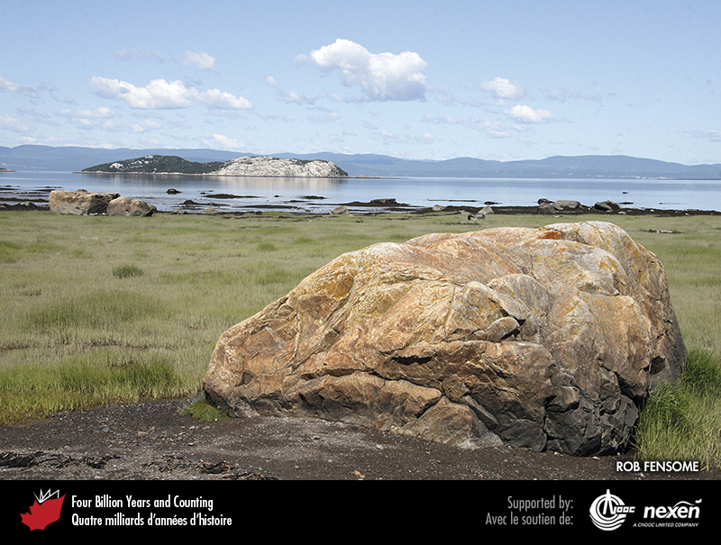
Notes:
Resistant quartz-rich Cambrian-Ordovician sandstones form distinctive hills and islands, such as the one in the distance, near Notre-Dame-du-Portage along the South Shore of the St. Lawrence River in Quebec. The sandstone was deposited in deep marine channels cut into the continental slope of Laurentia’s passive margin. In the foreground is a glacial boulder that is probably of the same rock. ROB FENSOME.
_______________________________
All photographic and graphic images (henceforth referred to as images) posted on this site are copyright of the persons and/or institutions indicated in the caption directly associated with each image. The copyright holders have agreed that you may use their images for educational, non-commercial purposes only and provided that they are credited in each instance of use. For all other uses you must contact the copyright holder.

Slide 10
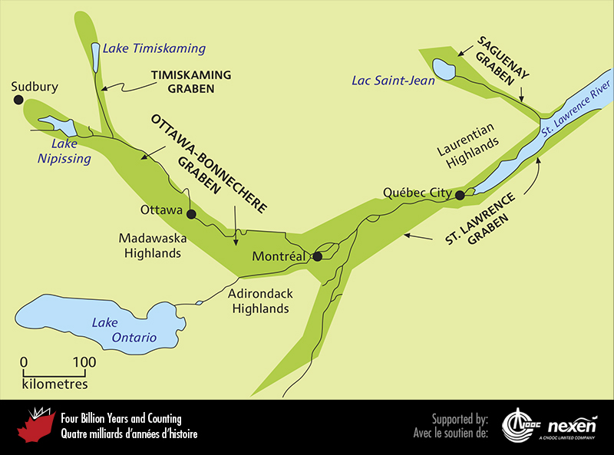
Notes:
As a prelude to the opening of the Iapetus Ocean, crustal stretching and the resulting normal faulting produced a series of rifts (or grabens) near what was to become the paleosouthern margin of Laurentia. Several of these late Neoproterozoic and earliest Paleozoic rifts underlay modern valleys, such as those of the St. Lawrence and Ottawa rivers. The modern southeastern margin of the St. Lawrence Graben was subsequently overridden by the thrust-and-fold belt of the Taconic Orogeny, as we will discover later in the chapter. ADAPTED FROM VARIOUS SOURCES.
_______________________________
All photographic and graphic images (henceforth referred to as images) posted on this site are copyright of the persons and/or institutions indicated in the caption directly associated with each image. The copyright holders have agreed that you may use their images for educational, non-commercial purposes only and provided that they are credited in each instance of use. For all other uses you must contact the copyright holder.

Slide 11
Notes:
Initial stages of drifting of the three terranes—Ganderia, Avalonia, and Meguma—across the Iapetus Ocean about 490 million years ago.
_______________________________
All photographic and graphic images (henceforth referred to as images) posted on this site are copyright of the persons and/or institutions indicated in the caption directly associated with each image. The copyright holders have agreed that you may use their images for educational, non-commercial purposes only and provided that they are credited in each instance of use. For all other uses you must contact the copyright holder.

Slide 12
Notes:
Vertically tilted, early to middle Cambrian turbidites at L’Islet-sur-Mer on the South Shore of the St. Lawrence River, Quebec. The turbidites accumulated on the passive margin off Laurentia. ROB FENSOME.
_______________________________
All photographic and graphic images (henceforth referred to as images) posted on this site are copyright of the persons and/or institutions indicated in the caption directly associated with each image. The copyright holders have agreed that you may use their images for educational, non-commercial purposes only and provided that they are credited in each instance of use. For all other uses you must contact the copyright holder.

