Slide 1
CHAPTER 7 Part 1 of 4
All photographic and graphic images (henceforth referred to as images) posted on this site are copyright of the persons and/or institutions indicated in the caption directly associated with each image. The copyright holders have agreed that you may use their images for educational, non-commercial purposes only and provided that they are credited in each instance of use. For all other uses you must contact the copyright holder.

Slide 2
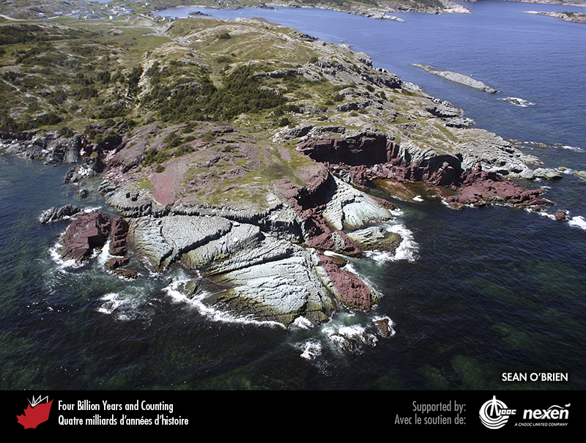
Notes:
Aerial view near Keels, Newfoundland, of Cambrian fluvial clastic rocks deposited on Avalonia, a microcontinent associated with the ancient Iapetus Ocean. SEAN O’BRIEN.
_______________________________
All photographic and graphic images (henceforth referred to as images) posted on this site are copyright of the persons and/or institutions indicated in the caption directly associated with each image. The copyright holders have agreed that you may use their images for educational, non-commercial purposes only and provided that they are credited in each instance of use. For all other uses you must contact the copyright holder.

Slide 3
Notes:
Geologic time scale, showing the interval covered in this chapter. Numbers indicate millions of years ago. P = Paleogene (Paleocene to Oligocene), N = Neogene (Miocene and Pliocene), and Q = Quaternary.
_______________________________
All photographic and graphic images (henceforth referred to as images) posted on this site are copyright of the persons and/or institutions indicated in the caption directly associated with each image. The copyright holders have agreed that you may use their images for educational, non-commercial purposes only and provided that they are credited in each instance of use. For all other uses you must contact the copyright holder.

Slide 4
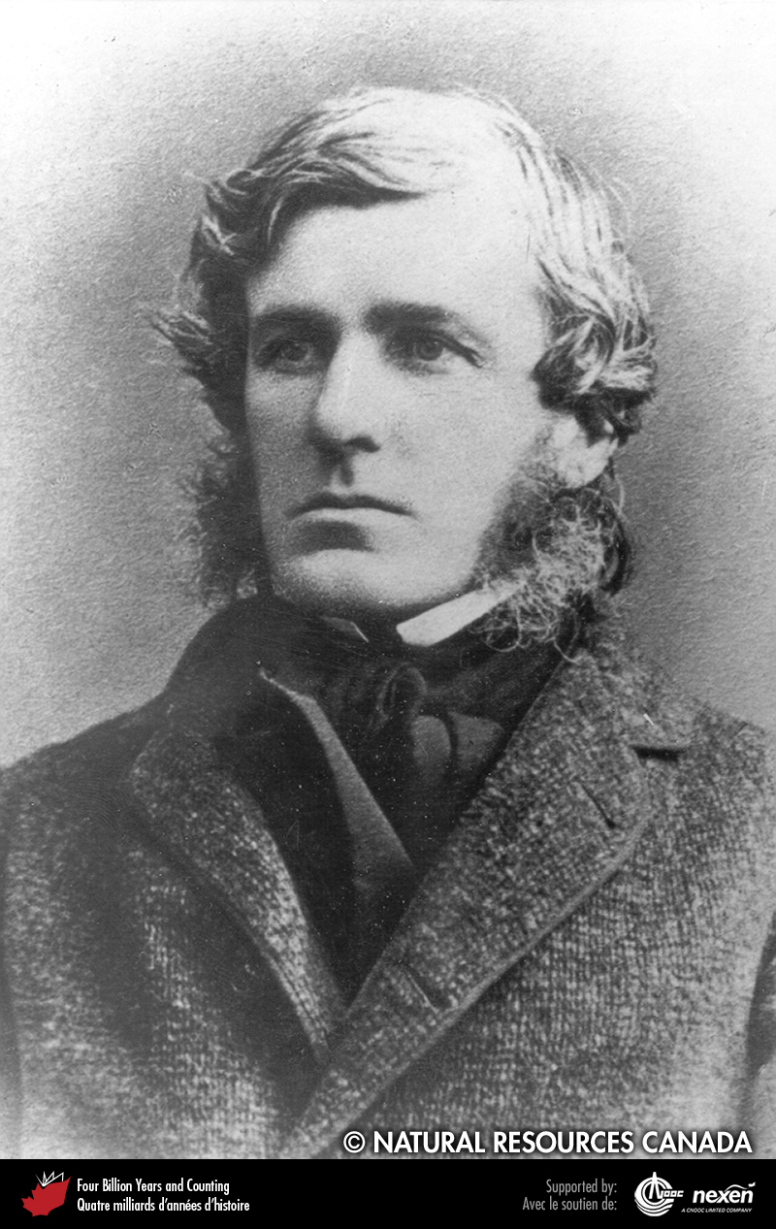
Notes:
Elkanah Billings, Canada’s first professional paleontologist. REPRODUCED WITH THE PERMISSION OF NATURAL RESOURCES CANADA 2013, COURTESY OF THE GEOLOGICAL SURVEY OF CANADA.
_______________________________
All photographic and graphic images (henceforth referred to as images) posted on this site are copyright of the persons and/or institutions indicated in the caption directly associated with each image. The copyright holders have agreed that you may use their images for educational, non-commercial purposes only and provided that they are credited in each instance of use. For all other uses you must contact the copyright holder.

Slide 5
Notes:
A specimen of Aspidella from the Avalon Peninsula, Newfoundland. DOUG BOYCE.
_______________________________
All photographic and graphic images (henceforth referred to as images) posted on this site are copyright of the persons and/or institutions indicated in the caption directly associated with each image. The copyright holders have agreed that you may use their images for educational, non-commercial purposes only and provided that they are credited in each instance of use. For all other uses you must contact the copyright holder.

Slide 6
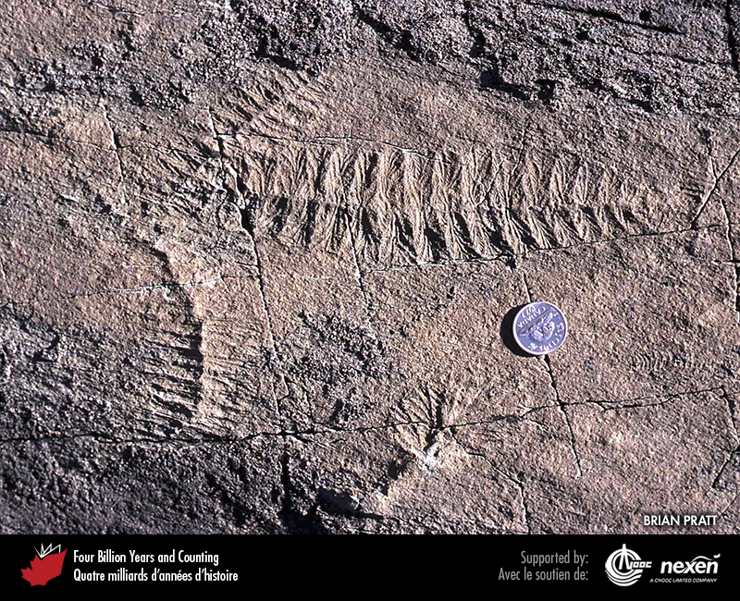
Notes:
Charniodiscus, a rangeomorph, from Mistaken Point, Newfoundland. BRIAN PRATT.
_______________________________
All photographic and graphic images (henceforth referred to as images) posted on this site are copyright of the persons and/or institutions indicated in the caption directly associated with each image. The copyright holders have agreed that you may use their images for educational, non-commercial purposes only and provided that they are credited in each instance of use. For all other uses you must contact the copyright holder.

Slide 7
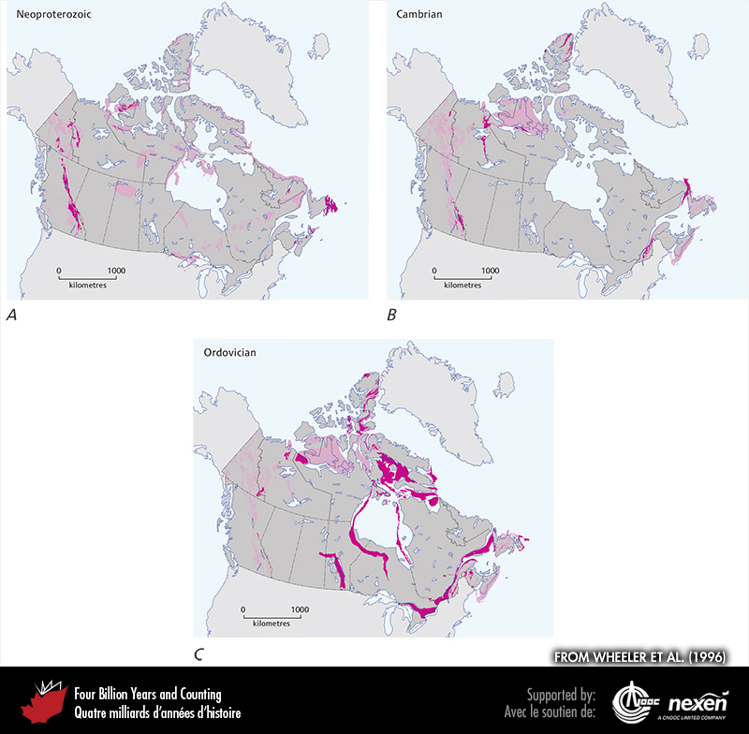
Notes:
General extent of Neoproterozoic (A), Cambrian (B), and Ordovician (C) rocks at the surface (beneath glacial deposits), onshore and offshore. The lighter shaded areas show either uncertainty or areas where rocks of the particular age have been confirmed but are intimately associated with rocks of other ages and the scale of the map does not allow us to show them separately. ADAPTED FROM WHEELER ET AL. (1996).
_______________________________
All photographic and graphic images (henceforth referred to as images) posted on this site are copyright of the persons and/or institutions indicated in the caption directly associated with each image. The copyright holders have agreed that you may use their images for educational, non-commercial purposes only and provided that they are credited in each instance of use. For all other uses you must contact the copyright holder.

Slide 8
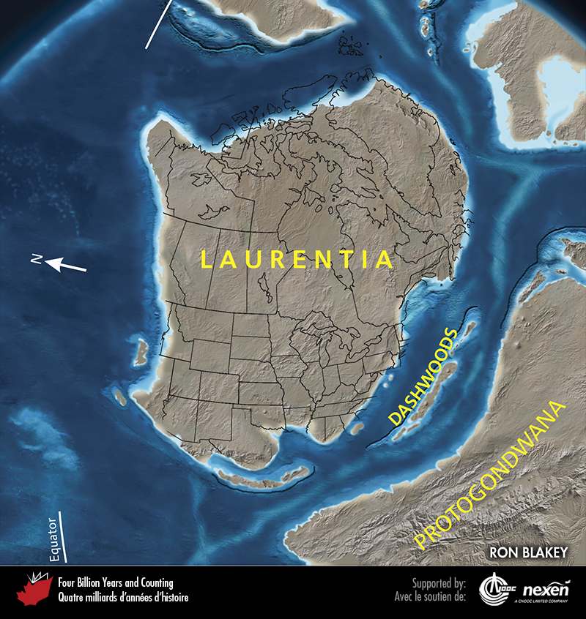
Notes:
Paleogeography of what was to become North America and adjacent regions in the late Ediacaran, 550 million years ago. Land is shown in brown, with shading showing topography. The lighter blue areas represent possible coastal or nearshore areas, darker blue represents deeper ocean waters, and black indicates trenches. Aspects of modern geography (including provincial and state boundaries) are shown for orientation.
_______________________________
All photographic and graphic images (henceforth referred to as images) posted on this site are copyright of the persons and/or institutions indicated in the caption directly associated with each image. The copyright holders have agreed that you may use their images for educational, non-commercial purposes only and provided that they are credited in each instance of use. For all other uses you must contact the copyright holder.

Slide 9
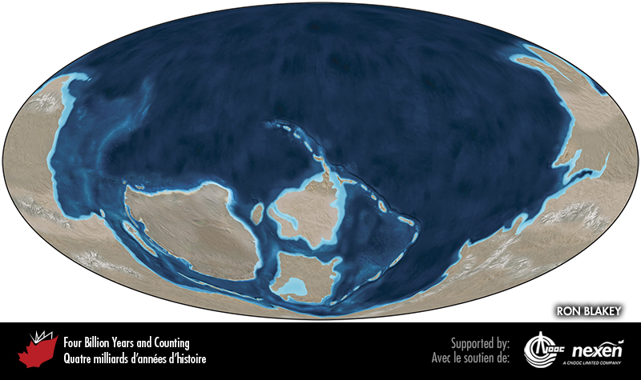
Notes:
Global paleogeography 550 million years ago, during the Ediacaran. Colours as for previous figure.
_______________________________
All photographic and graphic images (henceforth referred to as images) posted on this site are copyright of the persons and/or institutions indicated in the caption directly associated with each image. The copyright holders have agreed that you may use their images for educational, non-commercial purposes only and provided that they are credited in each instance of use. For all other uses you must contact the copyright holder.

Slide 10
Notes:
Deep-water Neoproterozoic strata of the Windermere Seaway exposed at Cushing Creek, British Columbia. These strata, dominated by thick sandstone beds, are interpreted as turbidites. BILL ARNOTT.
_______________________________
All photographic and graphic images (henceforth referred to as images) posted on this site are copyright of the persons and/or institutions indicated in the caption directly associated with each image. The copyright holders have agreed that you may use their images for educational, non-commercial purposes only and provided that they are credited in each instance of use. For all other uses you must contact the copyright holder.

Slide 11
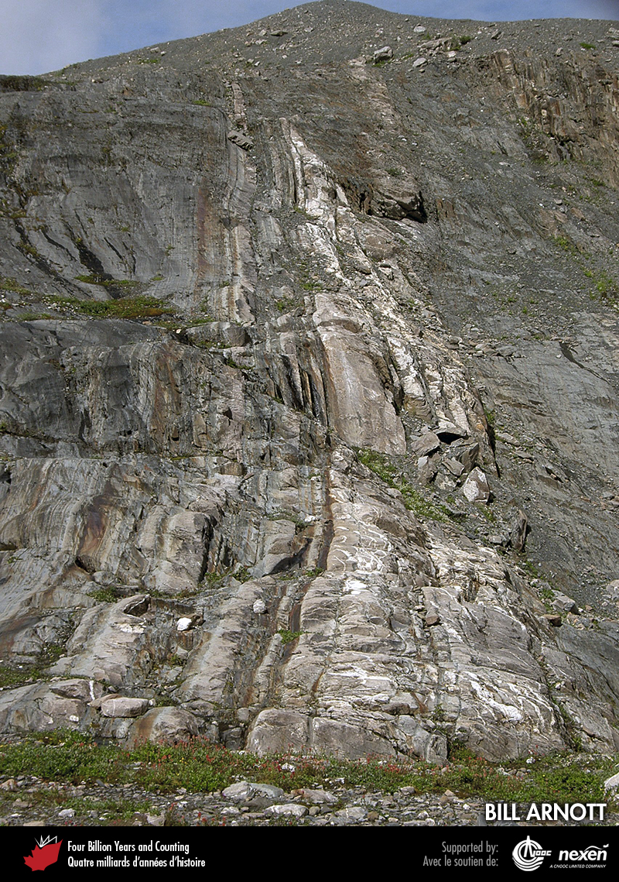
Notes:
Outcrops in the headwater region of Castle Creek, British Columbia, expose a deep-sea channel that formed on the flank of the Windermere Seaway during the Neoproterozoic. The channel deposits are lighter-coloured and steeply tilted. BILL ARNOTT.
_______________________________
All photographic and graphic images (henceforth referred to as images) posted on this site are copyright of the persons and/or institutions indicated in the caption directly associated with each image. The copyright holders have agreed that you may use their images for educational, non-commercial purposes only and provided that they are credited in each instance of use. For all other uses you must contact the copyright holder.

Slide 12
Notes:
Neoproterozoic strata with dropstones in a roadside exposure along Highway 3 near Creston, British Columbia. HU GABRIELSE.
_______________________________
All photographic and graphic images (henceforth referred to as images) posted on this site are copyright of the persons and/or institutions indicated in the caption directly associated with each image. The copyright holders have agreed that you may use their images for educational, non-commercial purposes only and provided that they are credited in each instance of use. For all other uses you must contact the copyright holder.

Slide 13
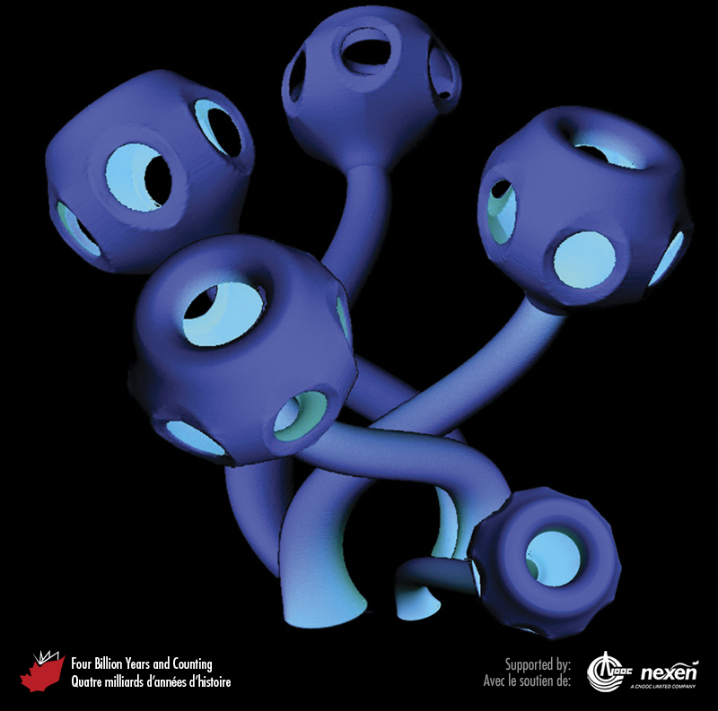
Notes:
Reconstruction of Namacalathus, one of the first animals to produce a skeleton formed of calcium carbonate, but of the mineral aragonite rather than the more usual skeletal mineral calcite. The stalk, which attached the animal to the sea floor, is about 2.5 centimetres long. The cup can be up to 2.5 centimetres wide but is usually less than 1 centimetre. Namacalathus occurs in the late Ediacaran rocks of British Columbia. The colours shown are not intended to be a true reflection of the colour of Namacalathus. FROM GROTZINGER ET AL. (2000); REPRODUCED WITH PERMISSION OF WES WATTERS, JOHN GROTZINGER, ANDREW KNOLL, AND THE JOURNAL PALEOBIOLOGY. A creative share-alike attribution only image.
_______________________________
All photographic and graphic images (henceforth referred to as images) posted on this site are copyright of the persons and/or institutions indicated in the caption directly associated with each image. The copyright holders have agreed that you may use their images for educational, non-commercial purposes only and provided that they are credited in each instance of use. For all other uses you must contact the copyright holder.

